Slide 1



PROJECT TITLE: “ACCES4ALL : TRANSFORMING EDUCATION THROUGH DIGITAL INCLUSION”

Slide 2
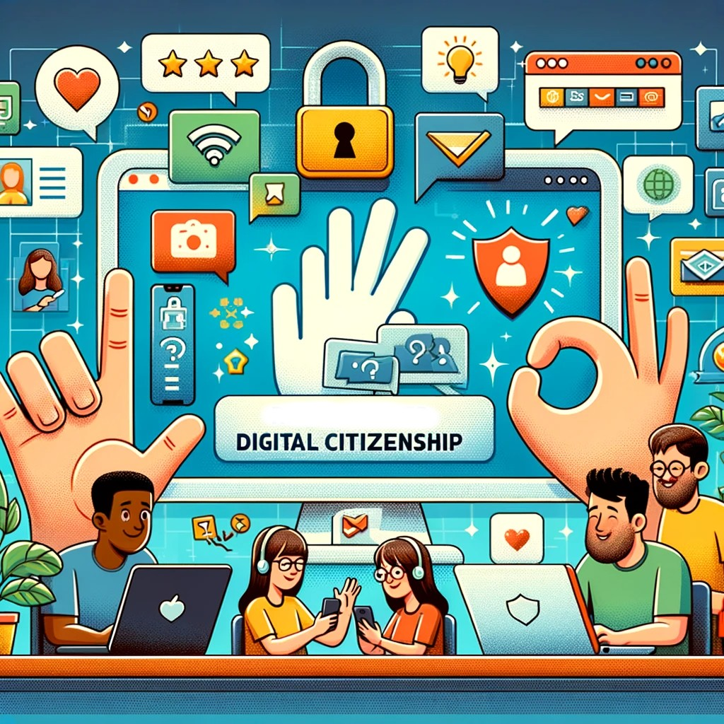
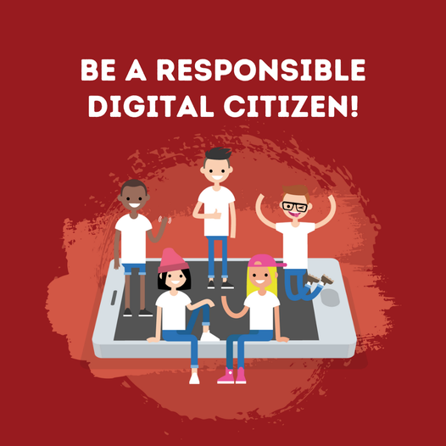
Cyber Heroes: Digital Citizenship & Cybersecurity
Welcome to the world of digital citizens!
Let’s explore how to stay safe, smart, and responsible online.

Slide 3
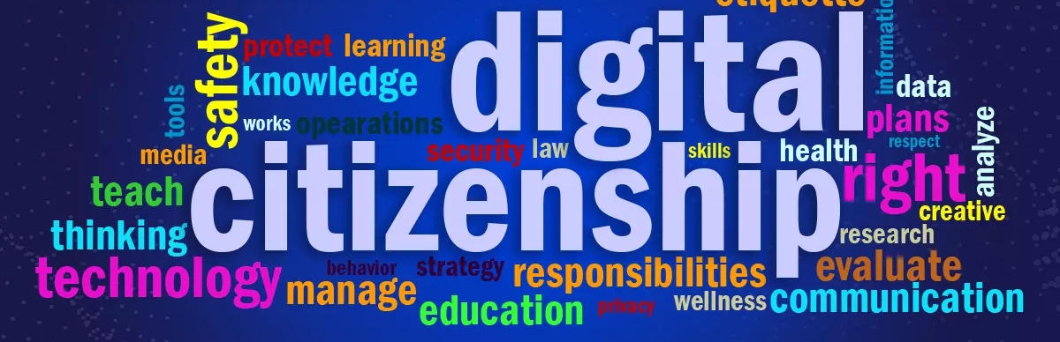
What is Digital Citizenship?
Digital citizenship means using technology and the Internet in a safe, respectful, and responsible way.
It’s about how we communicate, learn, and share in the digital world.
💬 What does being a good digital citizen mean to you?

Slide 4
Level 1: Strong Passwords 🔐
Your password is your first line of defense.
Weak passwords make you an easy target.
✅ Use at least 12 characters
✅ Mix upper/lowercase, numbers, symbols
✅ Never reuse the same password
Mini quiz:
Which password is the strongest?
A) password123
B) CatLover2020
C) $tR0ng!Pa55_24

Slide 5
Level 2: Phishing 🎣
Phishing is when someone tries to trick you into giving personal information.
How to recognize it:
• Check the sender’s email
• Don’t click strange links
• Real companies never ask for passwords by email
💡 Activity: Spot the fake email!

Slide 6
Level 3: Privacy & Social Media 🔒
Once something is online, it’s hard to remove.
Protect your digital footprint!
Tips:
• Review your privacy settings
• Think before posting
• Respect others’ privacy too
💬 Would you share your phone number on social media?

Slide 7
Level 4: Fake News 📰
Not everything online is true.
Fake news spreads quickly!
How to detect it:
• Check the source
• Compare with other sites
• Avoid sensational headlines
🧠 True or False:
You can trust every post shared by friends? (False!)

Slide 8
Be a Cyber Hero 🦸‍♀️
Every click counts. Think before you share, post, or download.
Together, we can make the Internet safer for everyone.
💪 Join the Cyber Hero Academy and protect the digital world!

Slide 9
Thank you for being part of our Cyber Heroes mission!

