Slide 1



Erasmus+
2024-1-FR01-KA220-SCH-000257061
CASE STUDIES –
"Collaborative Learning Platform"

Slide 2
Case Study 1: "Digital Guardians of the Planet"
Topic: Climate Change and Local Action
Level: Grades 4–6
Description:
Students from two partner schools (Poland and Portugal) are conducting a joint project on the impact of daily habits on the climate. Using digital tools (Google Forms, Excel Online, Canva), they are conducting a survey on energy consumption and transportation, analyzing the data, and then creating a digital awareness campaign titled "Small Steps – Big Change."

Slide 3
Digital Tools Used:
Google Forms – survey data collection
Canva / Genially – infographic and poster creation
Padlet – results publication and collaborative discussion
Meet / Zoom – meetings and results presentations

Slide 4
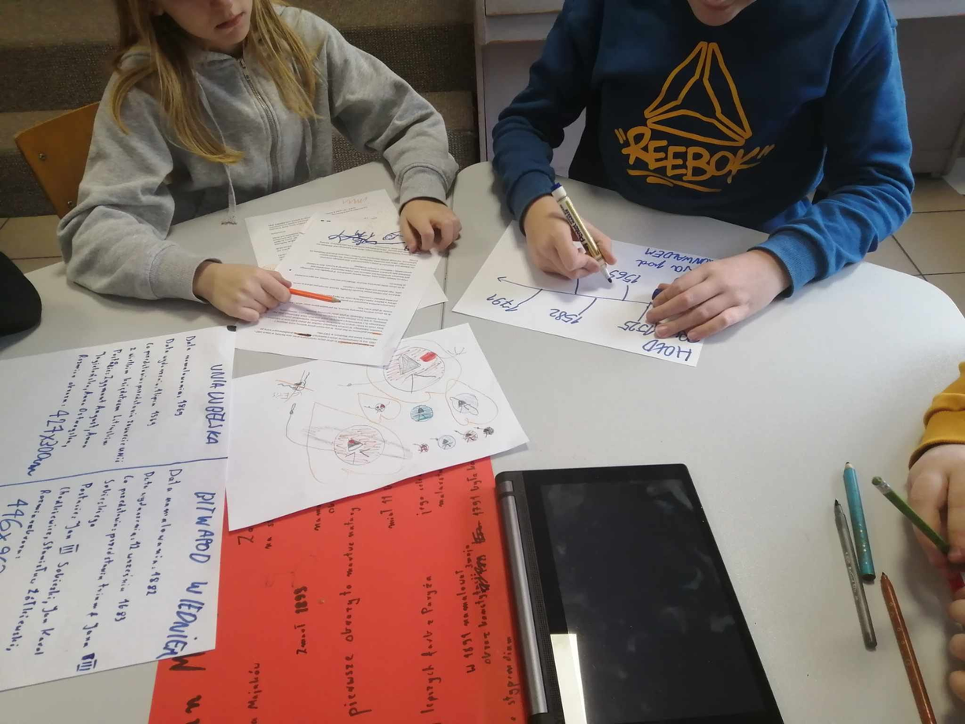
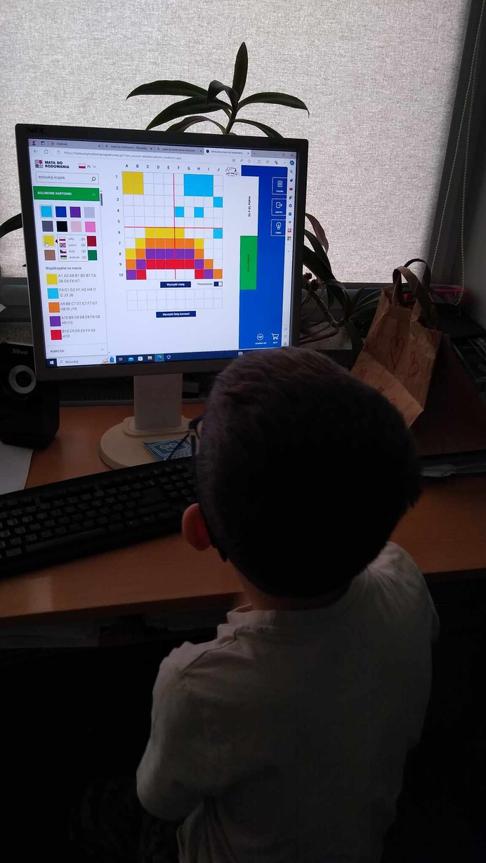

Slide 5
Outcomes:
Development of digital competencies: data analysis, visualization, online communication
Increased environmental awareness and social responsibility
Intercultural collaboration skills

Slide 6
Case Study 2: "Water is Life"
Topic: Sustainable water resource management
Level: Grades 1–3
Description:
Younger children learn about the importance of water by performing simple experiments and observations at home or at school.
They then create short videos or photos, which they then publish
on a collaborative platform.
Partners from other schools compare their activities and collaborate on a "Digital Water Book."

Slide 7
Digital tools used:
Book Creator / StoryJumper – creating a digital book
Flip / WeVideo – recording educational videos
Wakelet – collecting and organizing materials
Outcomes:
Developing creativity and digital expression
Introducing young children to the topic of sustainable development
Learning to collaborate and communicate online safely

Slide 8
Case Study 3: "EcoMap of My Neighbourhood"
Topic: Responsibility for the Local Environment
Level: Grades 7-8
Description:
Students create an interactive ecological map of their town, marking places related to nature conservation (e.g., green spaces, recycling points, zero-waste school). The project is carried out in collaboration with partners from other countries – each group creates a section of the map of their region and then combines the data into a single,
shared map of Europe.

Slide 9
Digital tools used:
Google My Maps / ArcGIS Online – map creation
Padlet / Jamboard – brainstorming and planning
Canva / Piktochart – digital report development
TwinSpace (eTwinning) – communication between schools

Slide 10
Outcomes:
Development of digital skills: geolocation, data visualization, teamwork
Development of civic and environmentally conscious attitudes
Deepening knowledge about sustainable development at the local and global levels

Slide 11
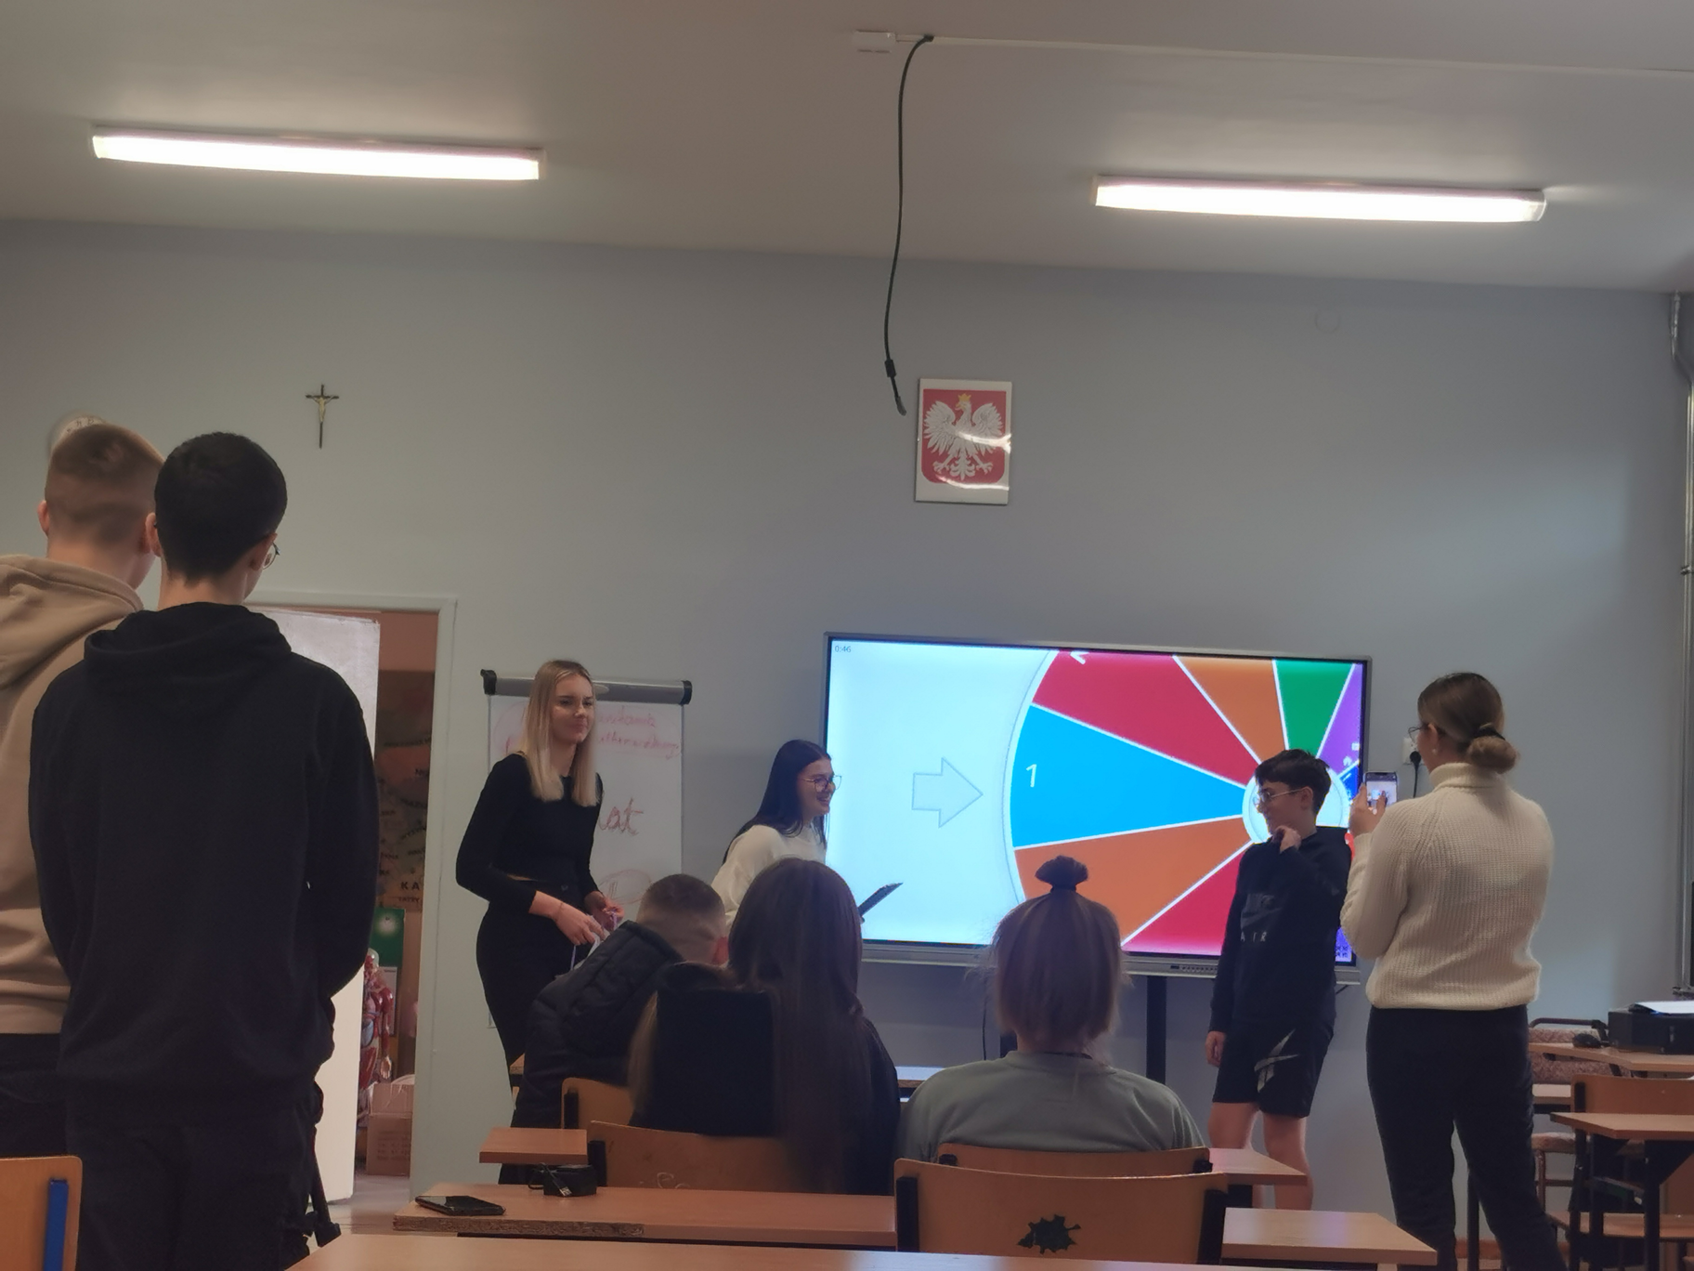

Slide 12
💡 SUGGESTED CONTENT
FOR THE "COLLABORATIVE LEARNING PLATFORM"
Module 1: Digital Collaborative Tools in Education for Sustainable Development
Interactive tutorials: "How to Use Padlet," "Creating Collaborative Maps in Google My Maps"
Online teamwork exercises (project planning, team roles, online safety)

Slide 13
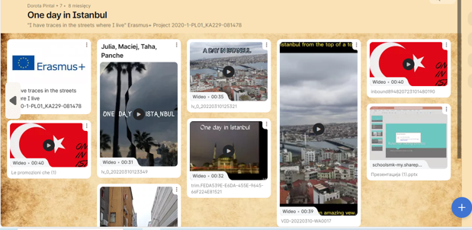

Slide 14
Module 2: Education for Sustainable Development
in Practice School
Thematic materials on the SDGs (Sustainable Development Goals)
Lesson plans and ideas for mini-digital projects (e.g., student carbon footprint, recycling at school)
Forum for exchanging good practices between teachers

Slide 15
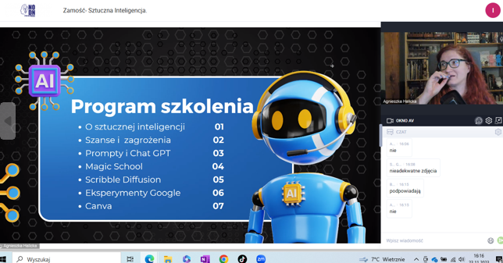

Slide 16
Module 3: Inter-school and intercultural collaboration
Teacher guide: how to find project partners and collaborate online
Materials on intercultural communication and digital empathy
Examples of good practices from eTwinning / Erasmus+ projects

Slide 17
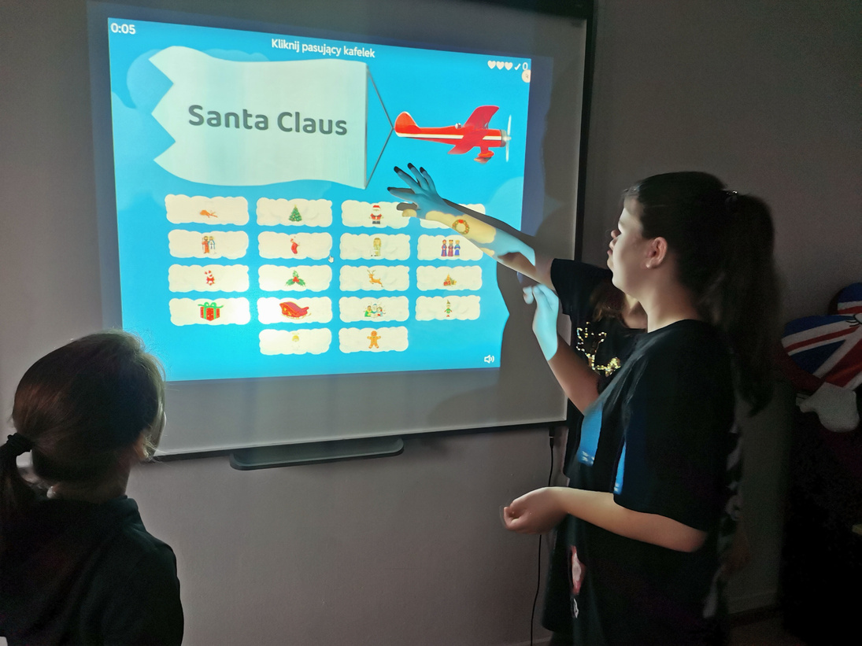
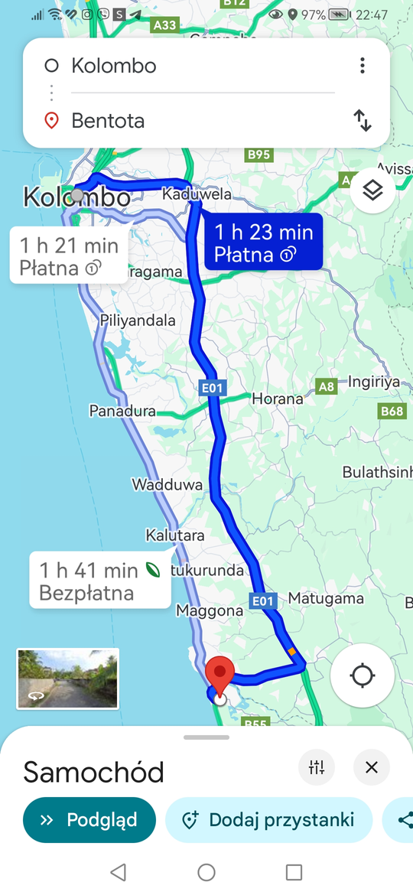

Slide 18
Module 4: Evaluation and reflection
Tools for self-assessing students' digital competences
Reflection cards on pro-environmental attitudes
Collaborative creation of an e-project portfolio

Slide 19
Structure of each module:
🧩 Module Name
🎯 Module Purpose
💻 Digital Tools
🌱 Link to the Sustainable Development Goals (SDGs)
👩‍🏫 Teacher Activities
👧👦 Student Activities
📊 Evaluation/Reflection

