Slide 1
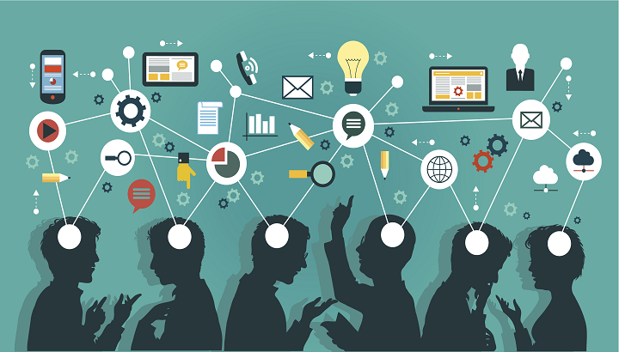
Dissemination strategy: sharing our impact
How we communicate results and inspire change

Slide 2



Slide 3

Dissemination strategy: sharing our impact
Welcome to our presentation on our Dissemination Strategy, where we explore how we plan to share the results, experiences, and impact of our project.

Slide 4
What is dissemination? – definition and importance
Dissemination means spreading information, ideas, results and experiences from a project to as many relevant people as possible.
It’s about making sure that what we’ve done doesn’t stay hidden and it reaches those who can benefit from it.
This process is crucial because it:
Helps others apply what we’ve discovered
Builds credibility for our work
Attracts new supporters and collaborators

Slide 5
Our goals and audiences – what we want to achieve and for whom
The main goal of our dissemination strategy is to maximize the reach and influence of our project. We want our work to matter to students, educators and communities.
With this project we aim to spread awareness of our goals and achievements, inspire similar initiatives in other schools or communities, encourage feeback and collaboration and so much more.
Our key audiences include:
Fellow students and teachers within our school
Other schools locally and nationally
International partners in education
Each group needs different messages and we tailor our communication accordingly.

Slide 6
LOCAL ACTIVITIES - INSIDE OUR SCHOOL AND COMMUNITY
Dissemination starts at home, within our school and local community.
We’ve organized a variety of activities to make our work visible and accessible:
Workshops and presantations in our school, where we showcased what we did and what we learned.
Classroom discussions to encourage reflection and student involvement.
Printed materials such as posters that were distributed around the school.

Slide 7
Digital tools – online sharing, visuals and platforms
To reach a broader audience, we used a variety of digital tools such as:
Social media platforms like Instagram and Facebook to post updates, photos and short videos
Infographics and videos to visually represent our data and impact in an engaging way.
Emails newsletters sent to teachers, parents, and partners to keep them informed.
These tools helped us stay connected with our audiences and made our project more accessible and shareable.

Slide 8
Wider dissemination – national/international actions
Beyond our school and community, we’ve taken steps to share our work on a larger scale:
We connected with educational institutions in other regions or countries.
Participated in conferences, seminars or online forums to present our project.
Shared our materials and experiences with educational networks.
These efforts help us ensure our project has a wider impact and contributes to global conversations.

Slide 9
Monitoring & sustainability – how we keep results alive
Dissemination isn’t just about sharing, it’s about making sure our work continues to matter. That’s why we have a plan to monitor and sustain our results.
We’ve created clear documentation and recources so others can use or adapt our ideas.
Teachers and students are encouraged to integrate project themes into future work.
We’ll continue to collect data and feedback to measure ongoing impact.
The project will remain visible through permanent displays, digital archives and regular follow-ups.
By doing this, we aim to keep the momentum going long after the project is officially over.

Slide 10
Conclusion – summary and call to action
In conclusion, dissemination helps us extend the life and value of our project. Through local engagement, digital outreach, and national/international collaboration, we are ensuring that our efforts create real and lasting change.
Our call to action:
We invite everyone, students, educators, community members, and partners to continue the conversation. Share your ideas, spread the word, and let’s keep building on this work together!

Slide 11
Thank you for your time and attention!

