Slide 1



Digital ethical use
Eco & NET HEROES

Slide 2
Key principles of digital ethics
RESPECT FOR OTHERS
Treat people online like you’d treat them face-to-face with kindness and respect. This means avoiding cyberbullying, trolling, hate speech, or spreading hurtful messages . And before you share someone elses photo, or personal story, always ask for their permission first.

Slide 3

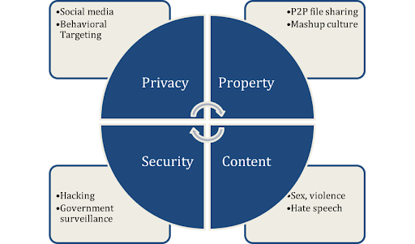
What is digital ethical use
Digital ethical use is about using thechnology, the internet, and digital tools in ways that are responsible ,respectful,honest,and fair.
Think of it as bringing your real world values into the online space making thoughtful choices about how you interact with others, handle information, and use digital resources.

Slide 4

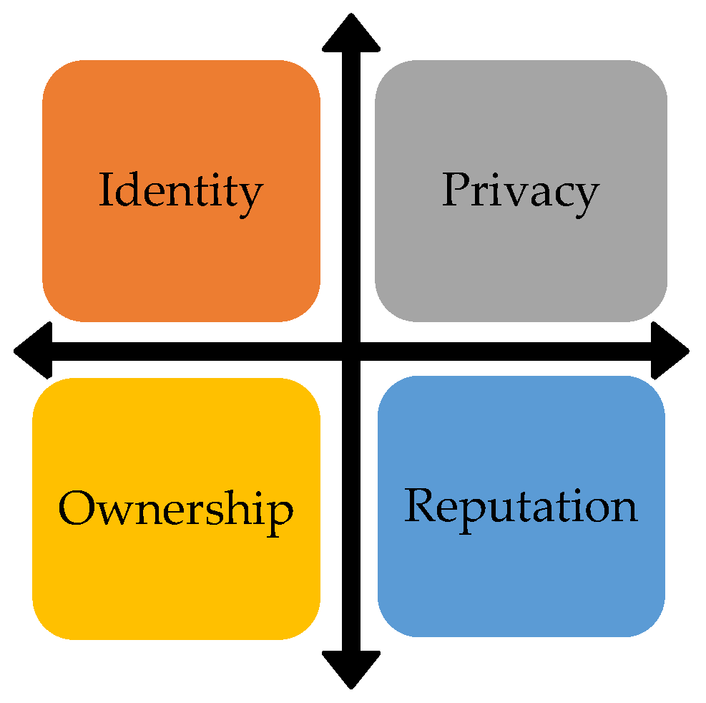
Common Ethical Issues Online
Cyberbullying and harassment
Spreading false or misleading information
Copying content without credit
Invasion of privacy and data misuse

Slide 5

How to Use Technology Ethically
Ask permission before sharing someone’s photo or data.
Use secure passwords and respect online privacy settings.
Always credit original creators of content.
Report harmful or unethical online behavior.

Slide 6
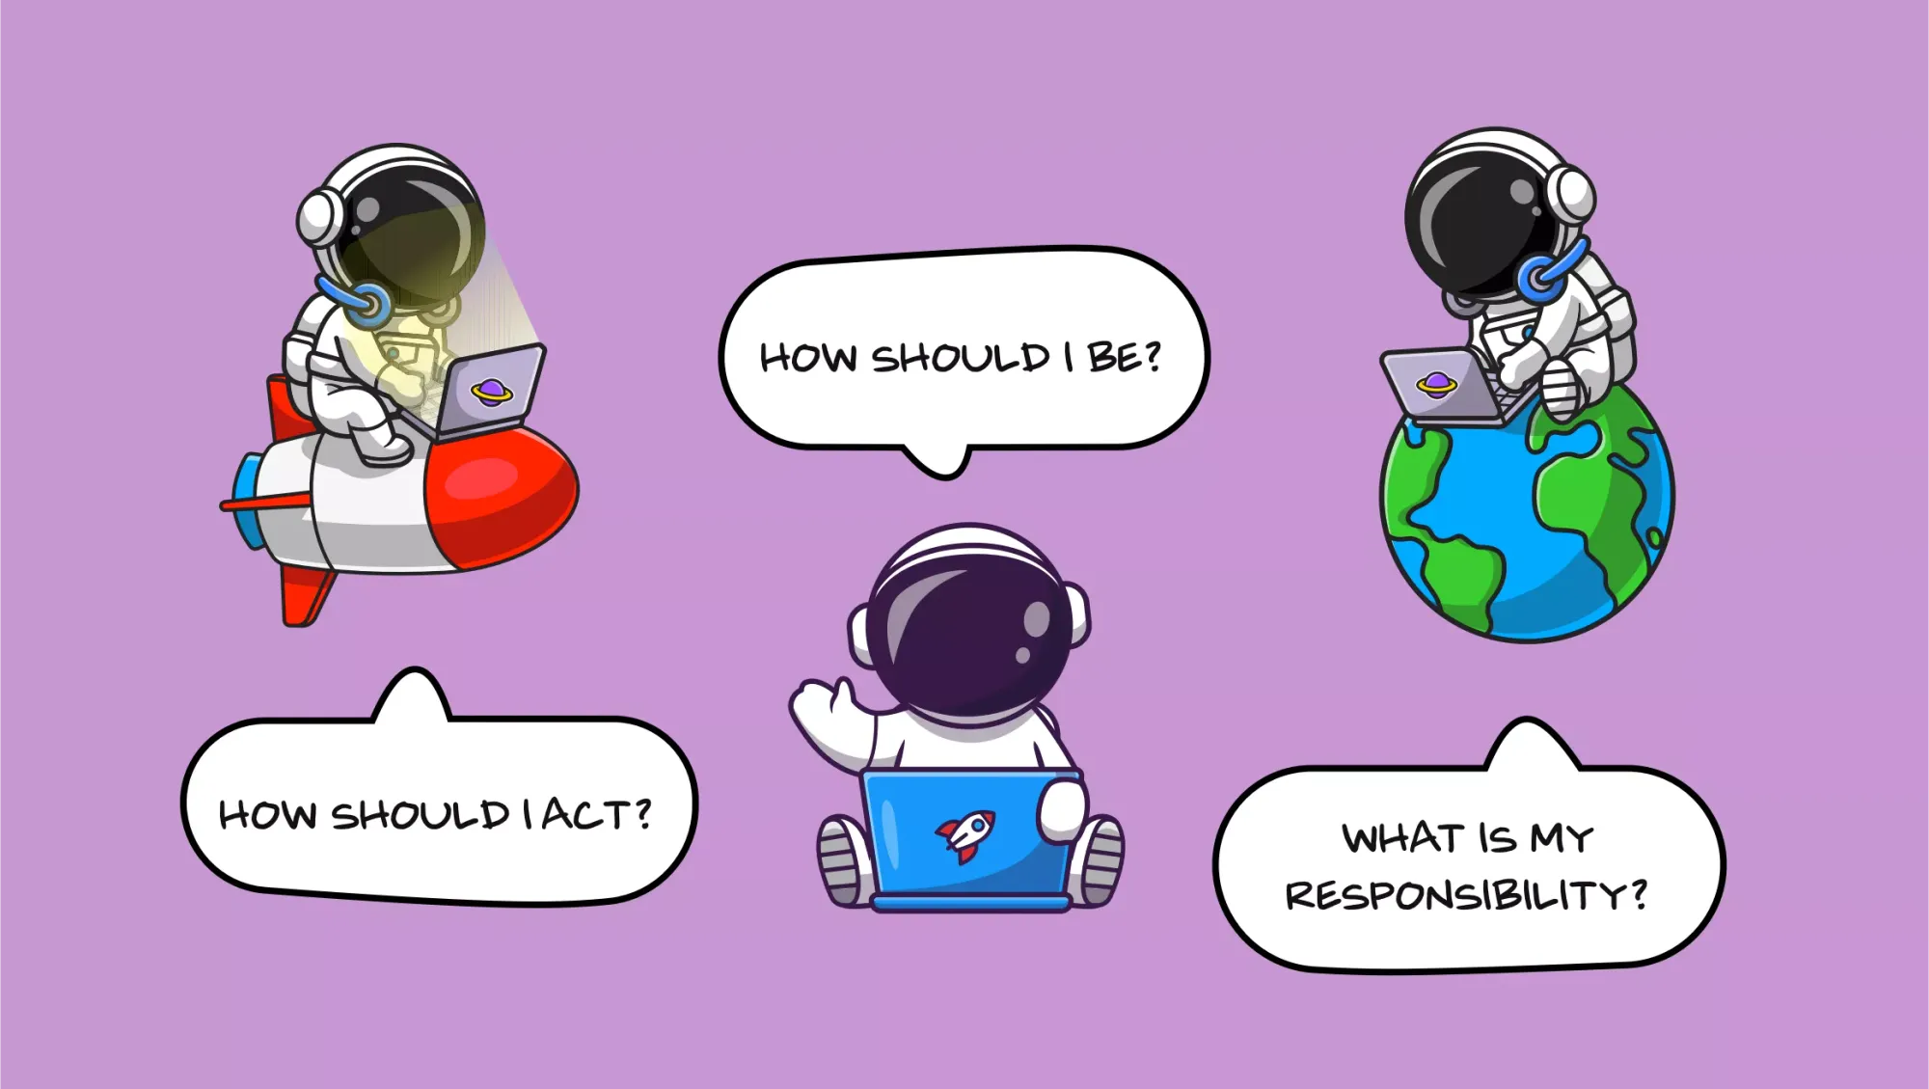
Why Digital Ethics Matters
Builds a positive digital reputation.
Encourages trust and cooperation online.
Helps create a safer, fairer digital world for everyone.
Remember: Ethical choices online reflect who you are offline.

Slide 7

The Future of Digital Ethics
As technology continues to grow, ethical use becomes even more important.We must think carefully about how digital tools affect others.Learning and teaching digital ethics helps create a responsible and respectful online culture.The future of technology depends on the ethical choices we make today.

Slide 8
Here we have made a quiz about our project. you should open your kahoot on your browser and we will tell you the code
https://create.kahoot.it/details/digital-ethical-use/4d4a1e2c-cae0-4d64-8072-7642c686a36c

