Slide 1


Acces4All :
«Transforming Education through Digital Inclusion»

Slide 2
Sharing successful environmental education projects at 2nd Secondary school of Perama.
"Green" educational content creation workshop.

Slide 3
fields of application of environmental education at the 2nd secondary school of Perama.
tree planting
planting herbs
water saving
recycling of materials
growing vegetables

Slide 4
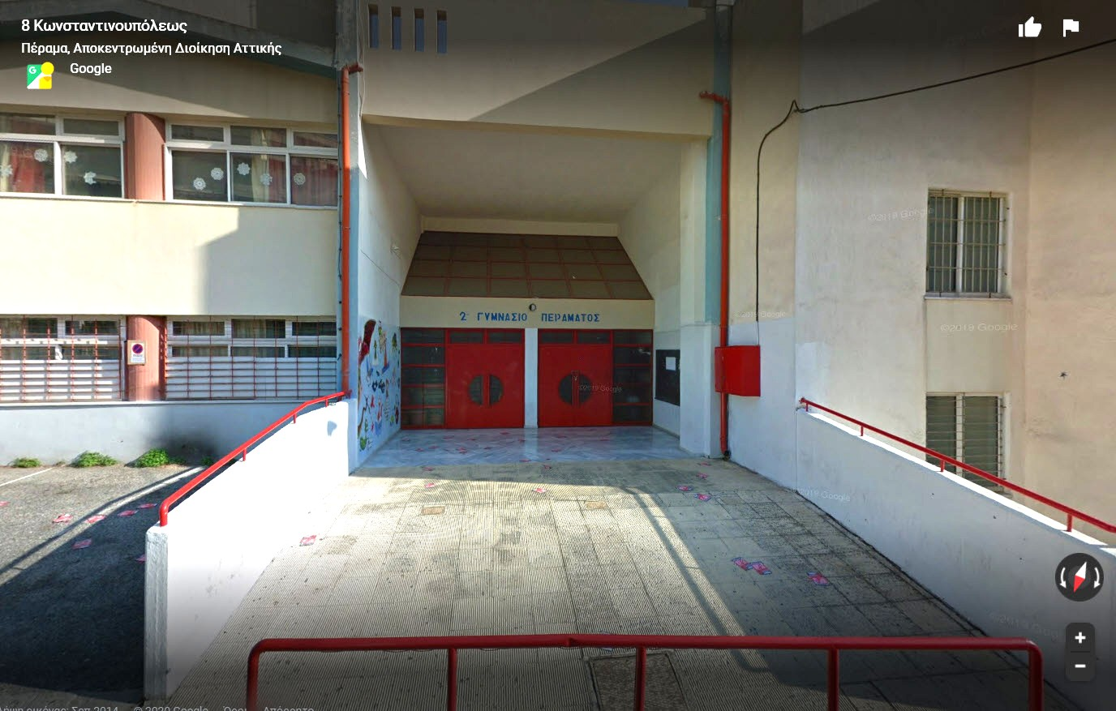
Tree planting
Our school was completely lacking in greenery, resulting in high temperatures in the building, especially during the summer months.

Slide 5
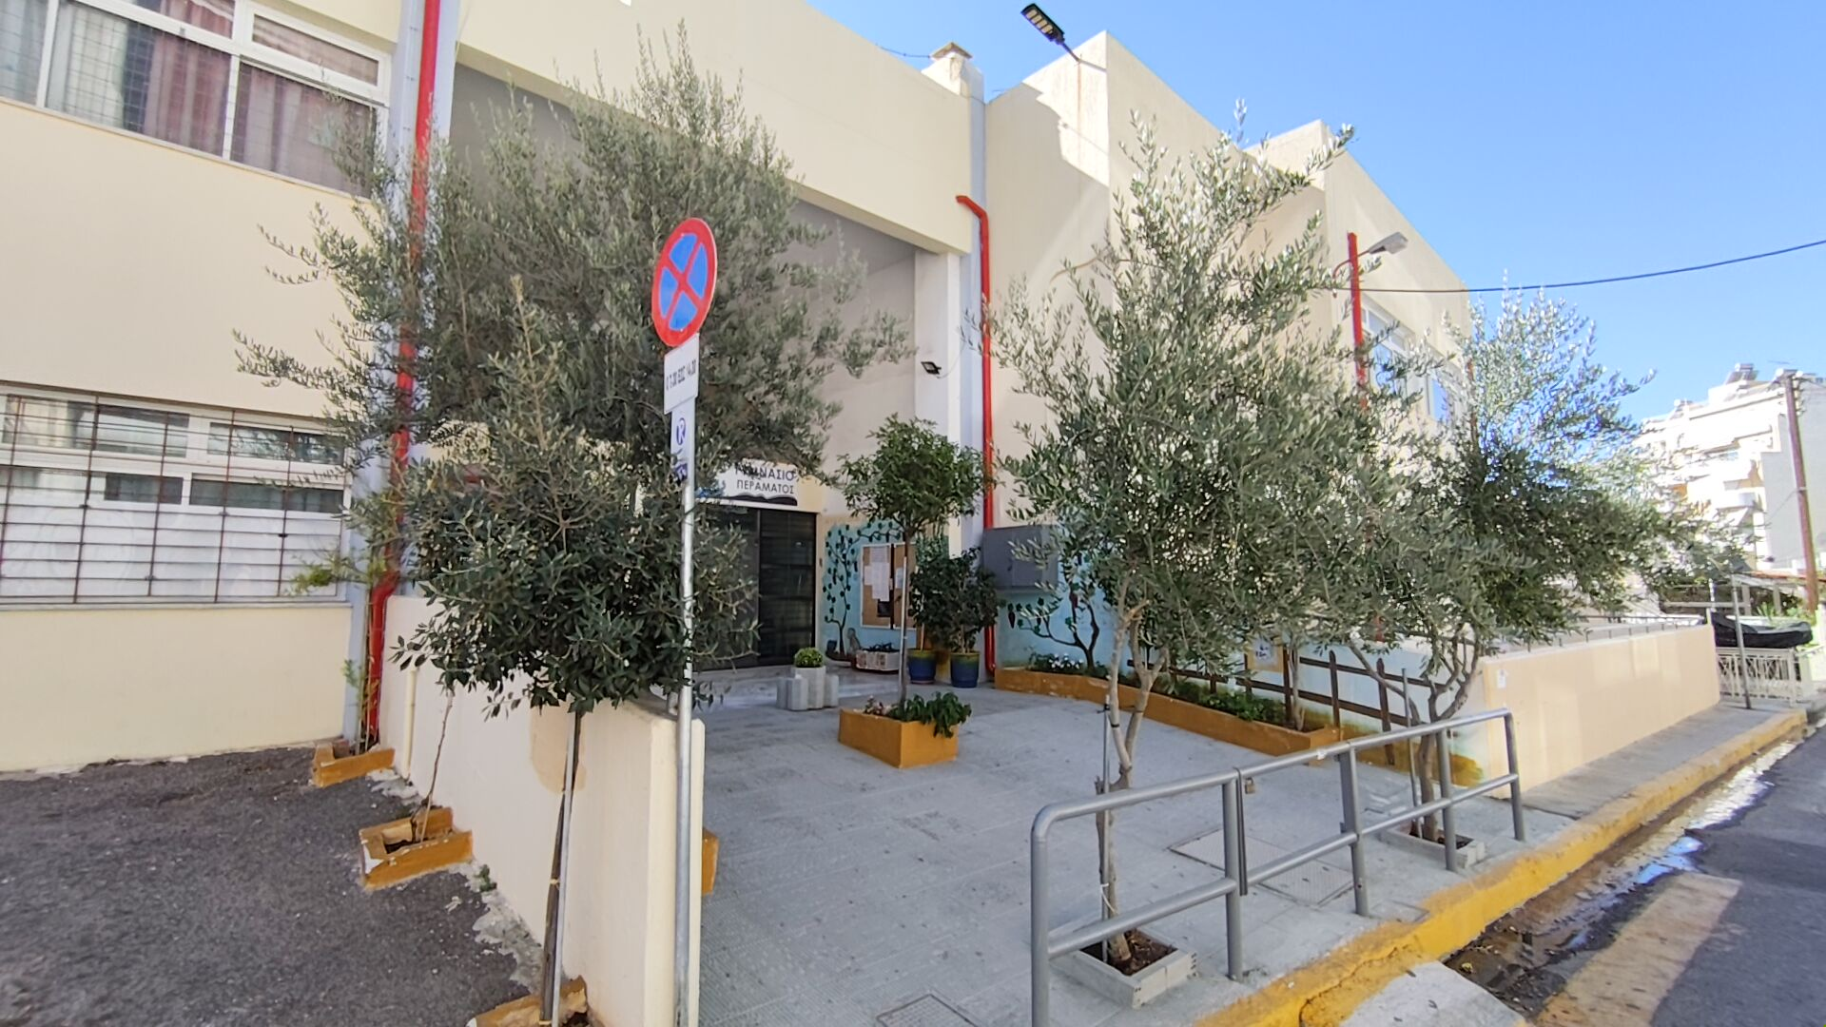
By planting several trees in the areas, we achieved, in addition to the aesthetic improvement, a drop in temperatures.

Slide 6
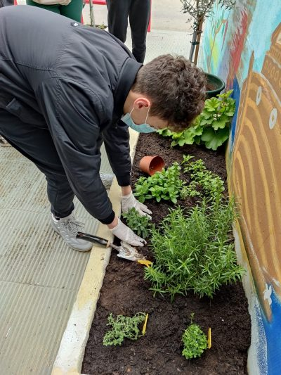
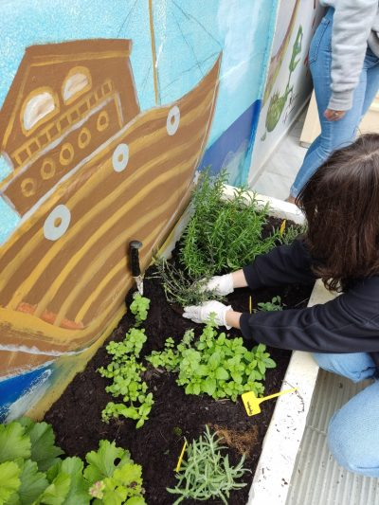
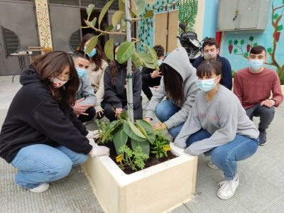
Planting herbs
By cultivating herbs, we learned about their exceptional properties for our health and their usefulness in nutrition.

Slide 7
Water saving
In a previous project, we had the opportunity to build “smart watering” planters and pots. The material they were made of absorbed enough water that it gradually released to the plant over a long period of time, avoiding evaporation.

Slide 8
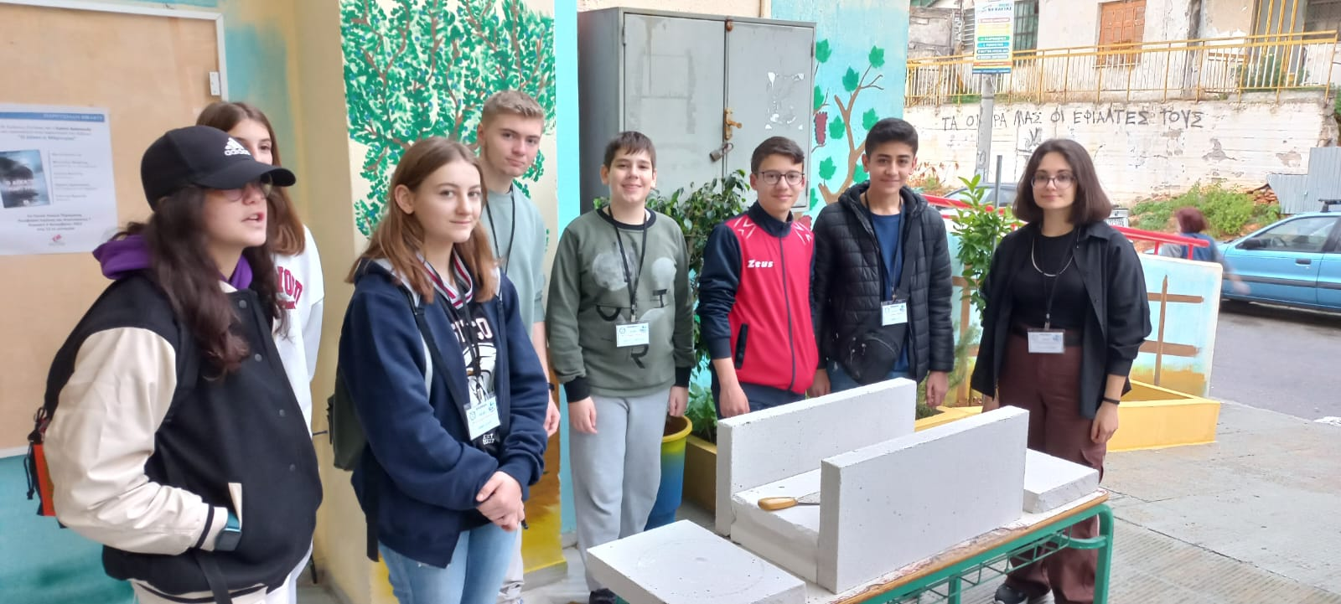
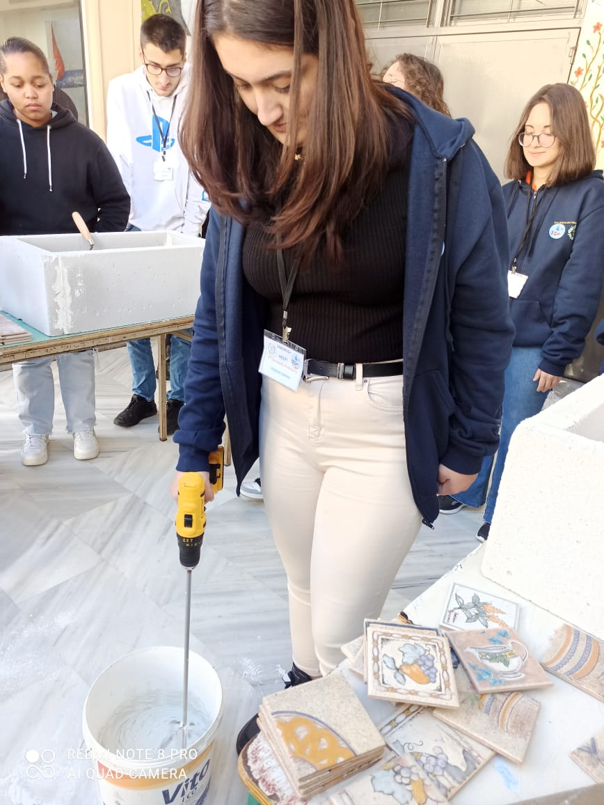
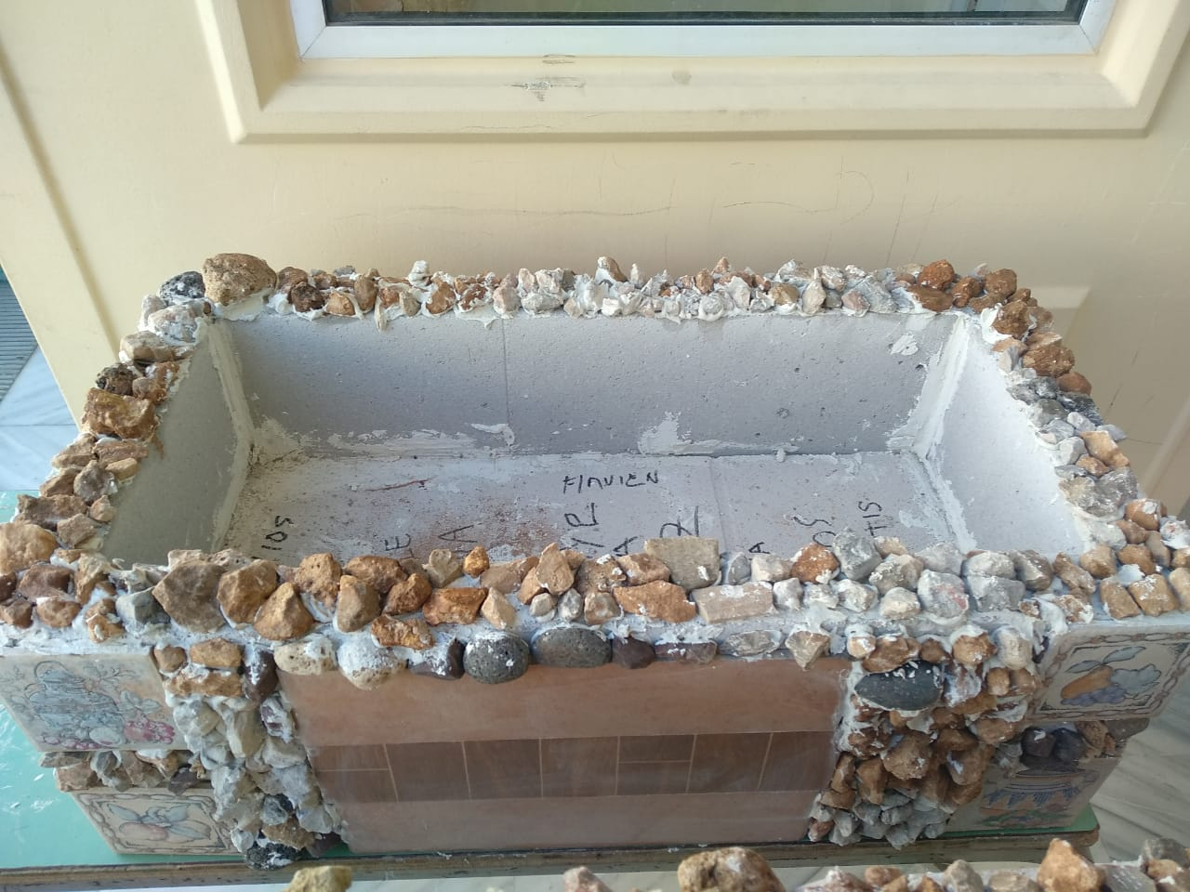

Slide 9
Recycling of materials
We made furniture from pallets, successfully recycling them, freeing the environment from unnecessary garbage. The result from an aesthetic point of view was excellent.

Slide 10
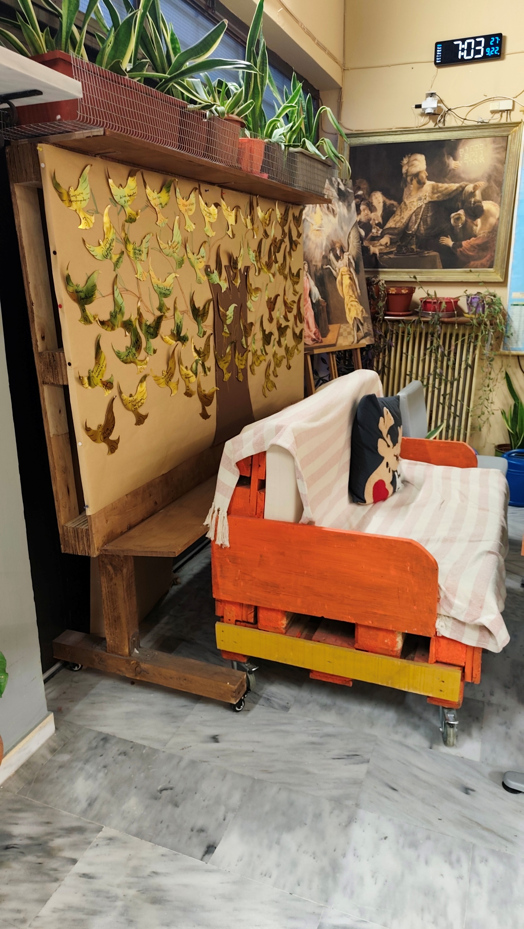
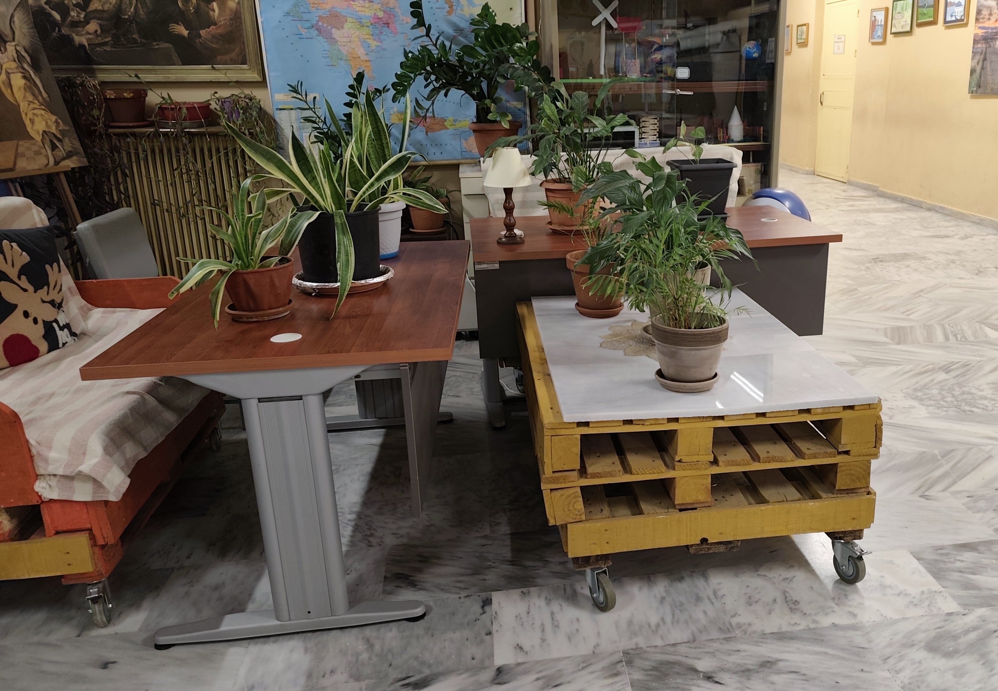

Slide 11
Growing vegetables
At our school we developed an action by growing vegetables in our school yard. Tomatoes, onions and other vegetables were planted and we watched them grow.

Slide 12
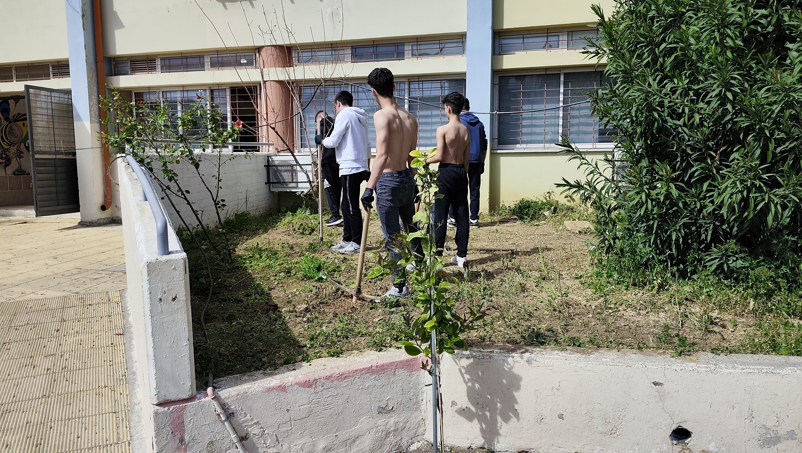

Slide 13
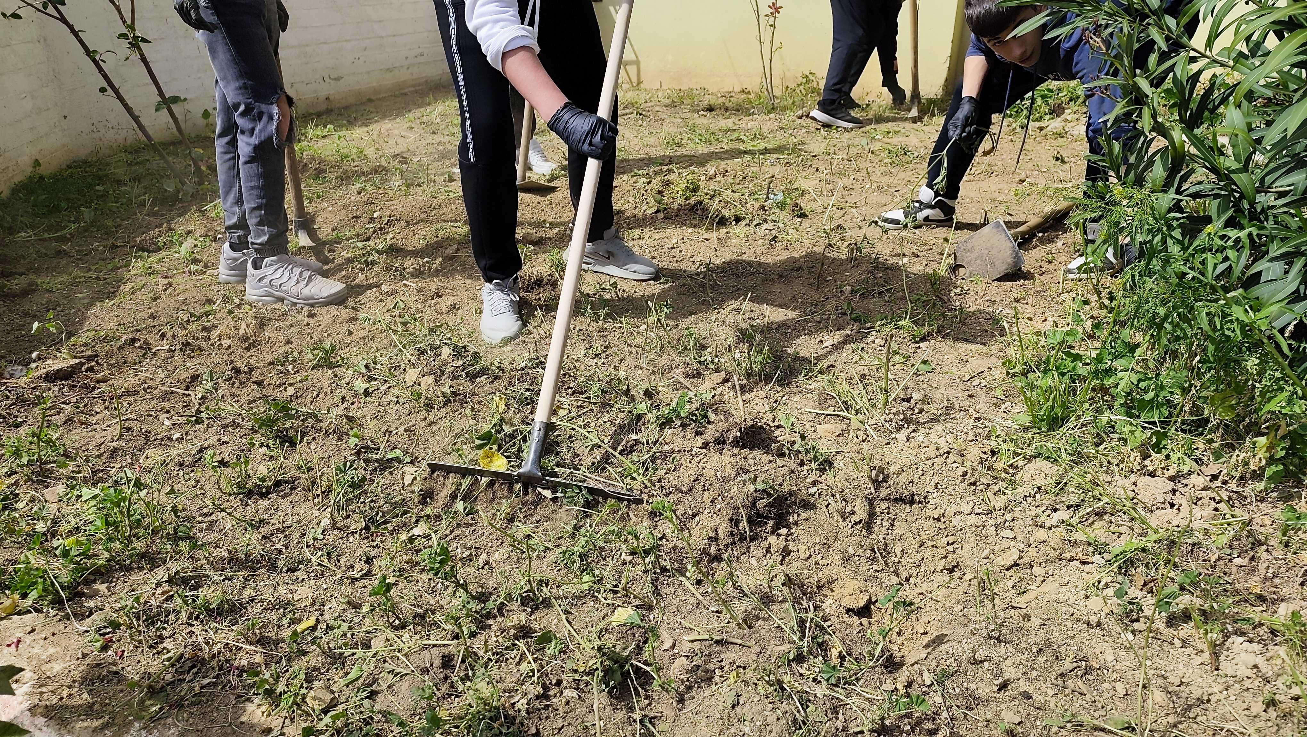

Slide 14
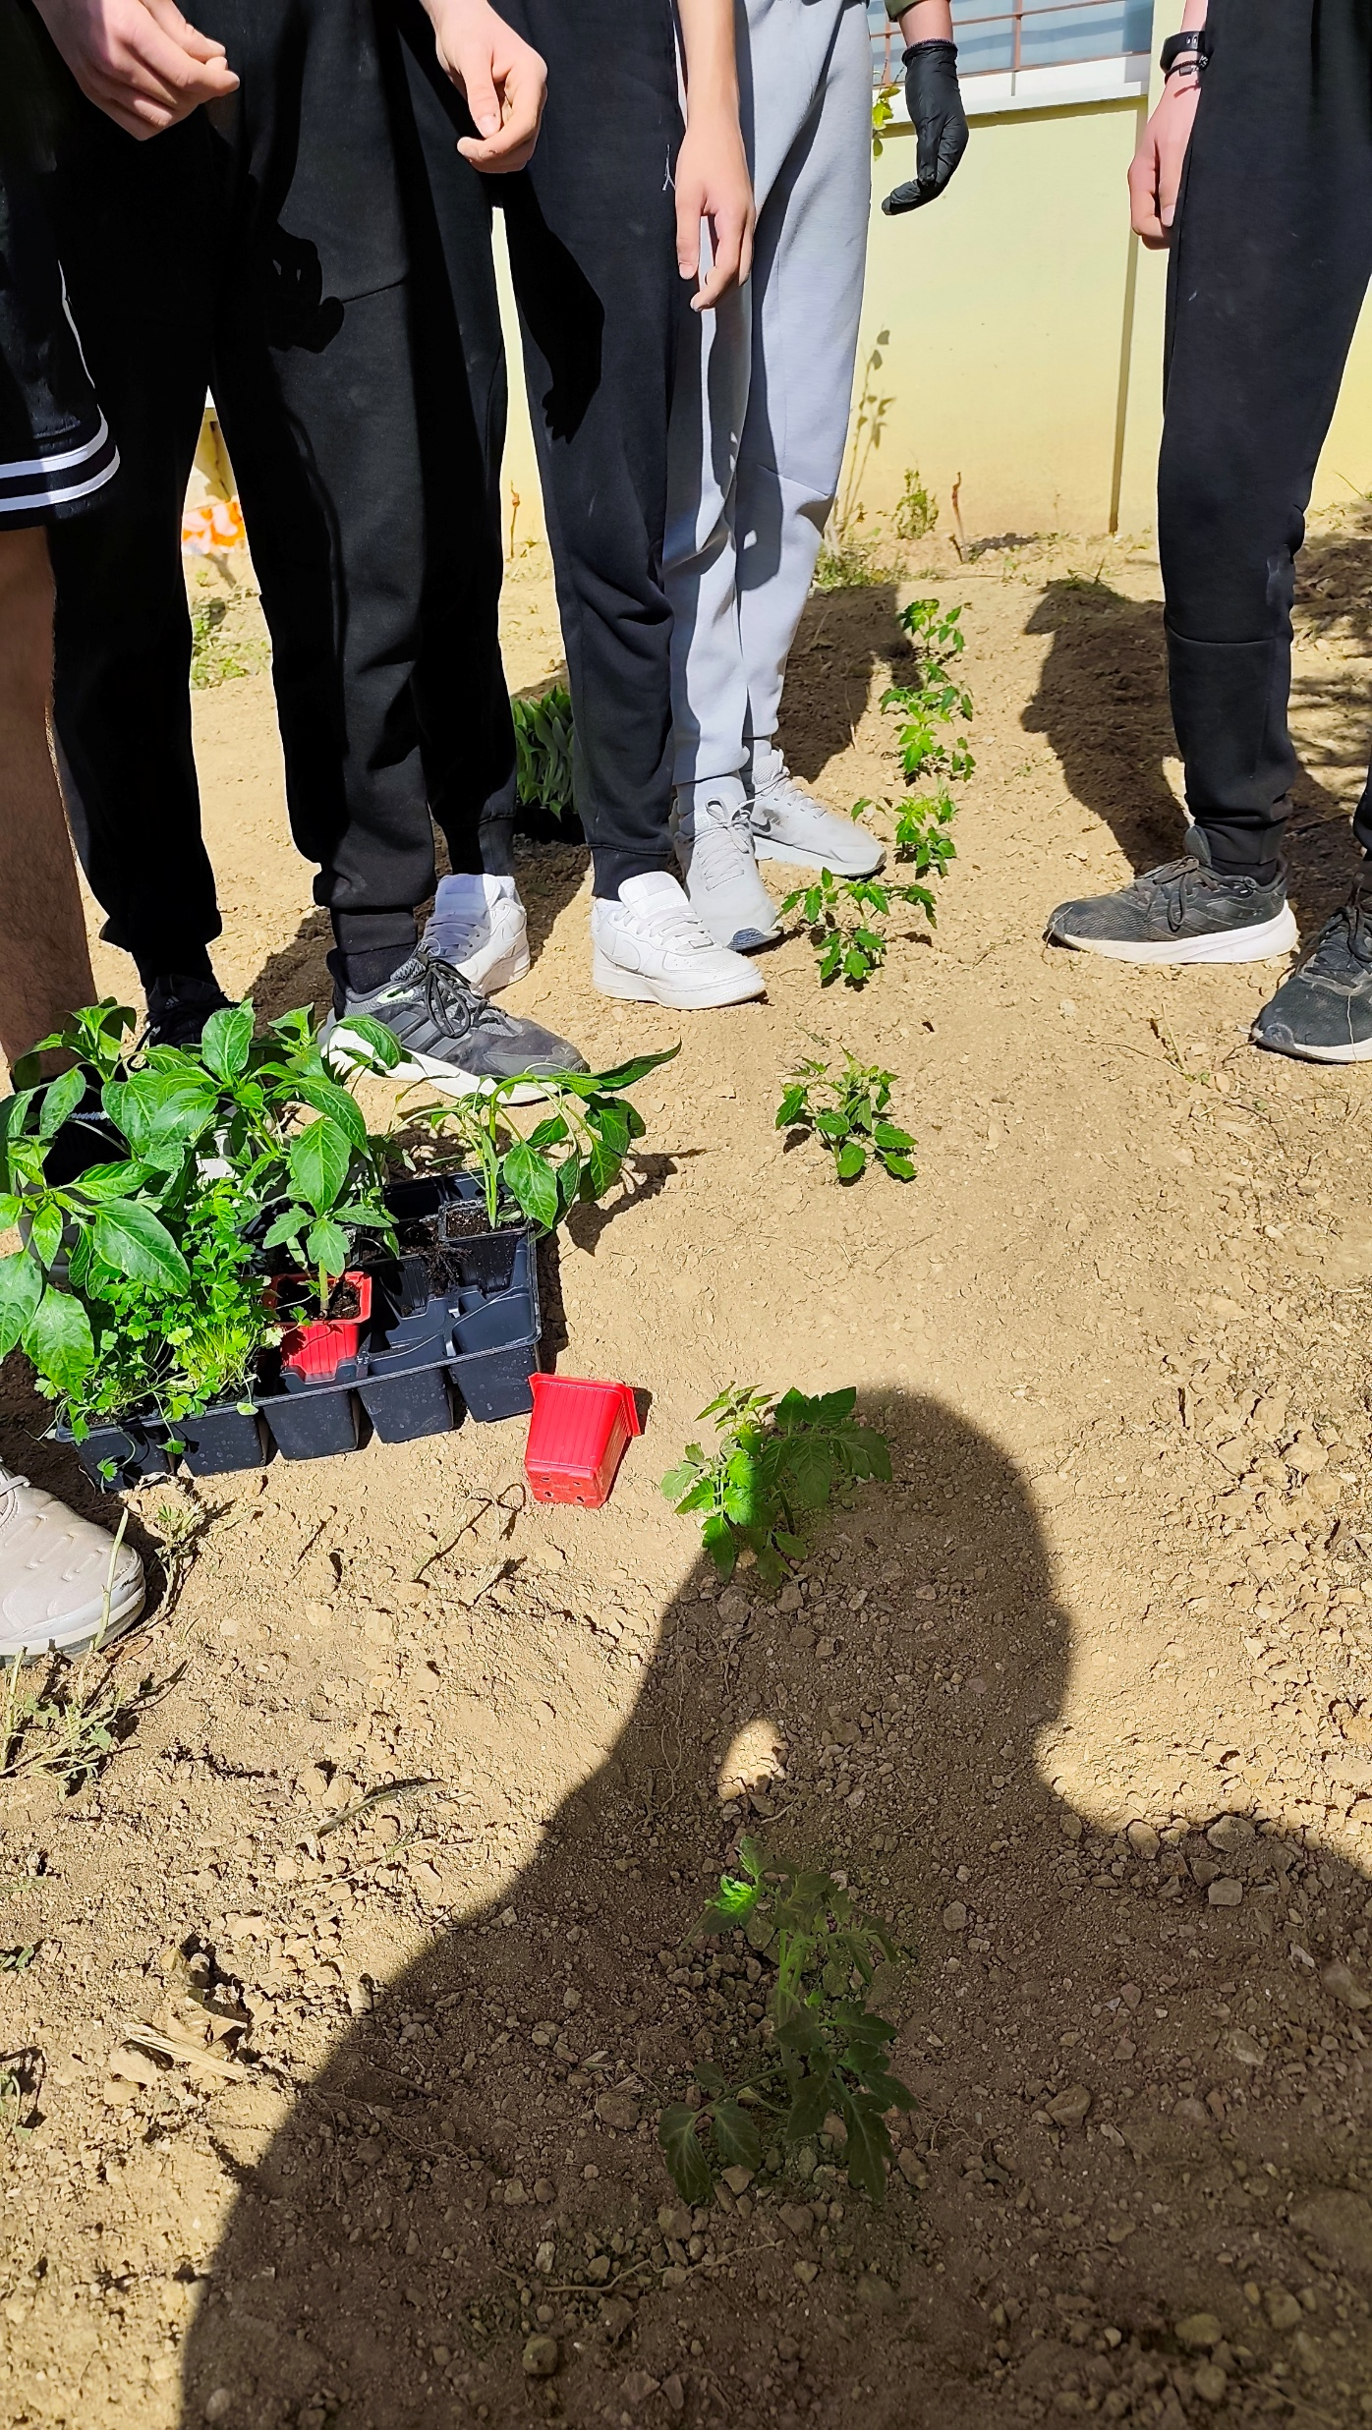
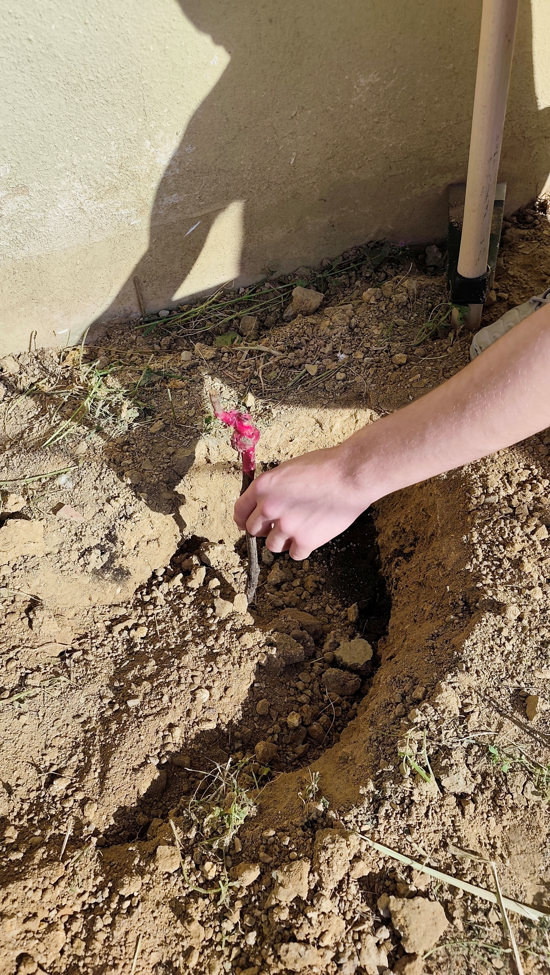

Slide 15
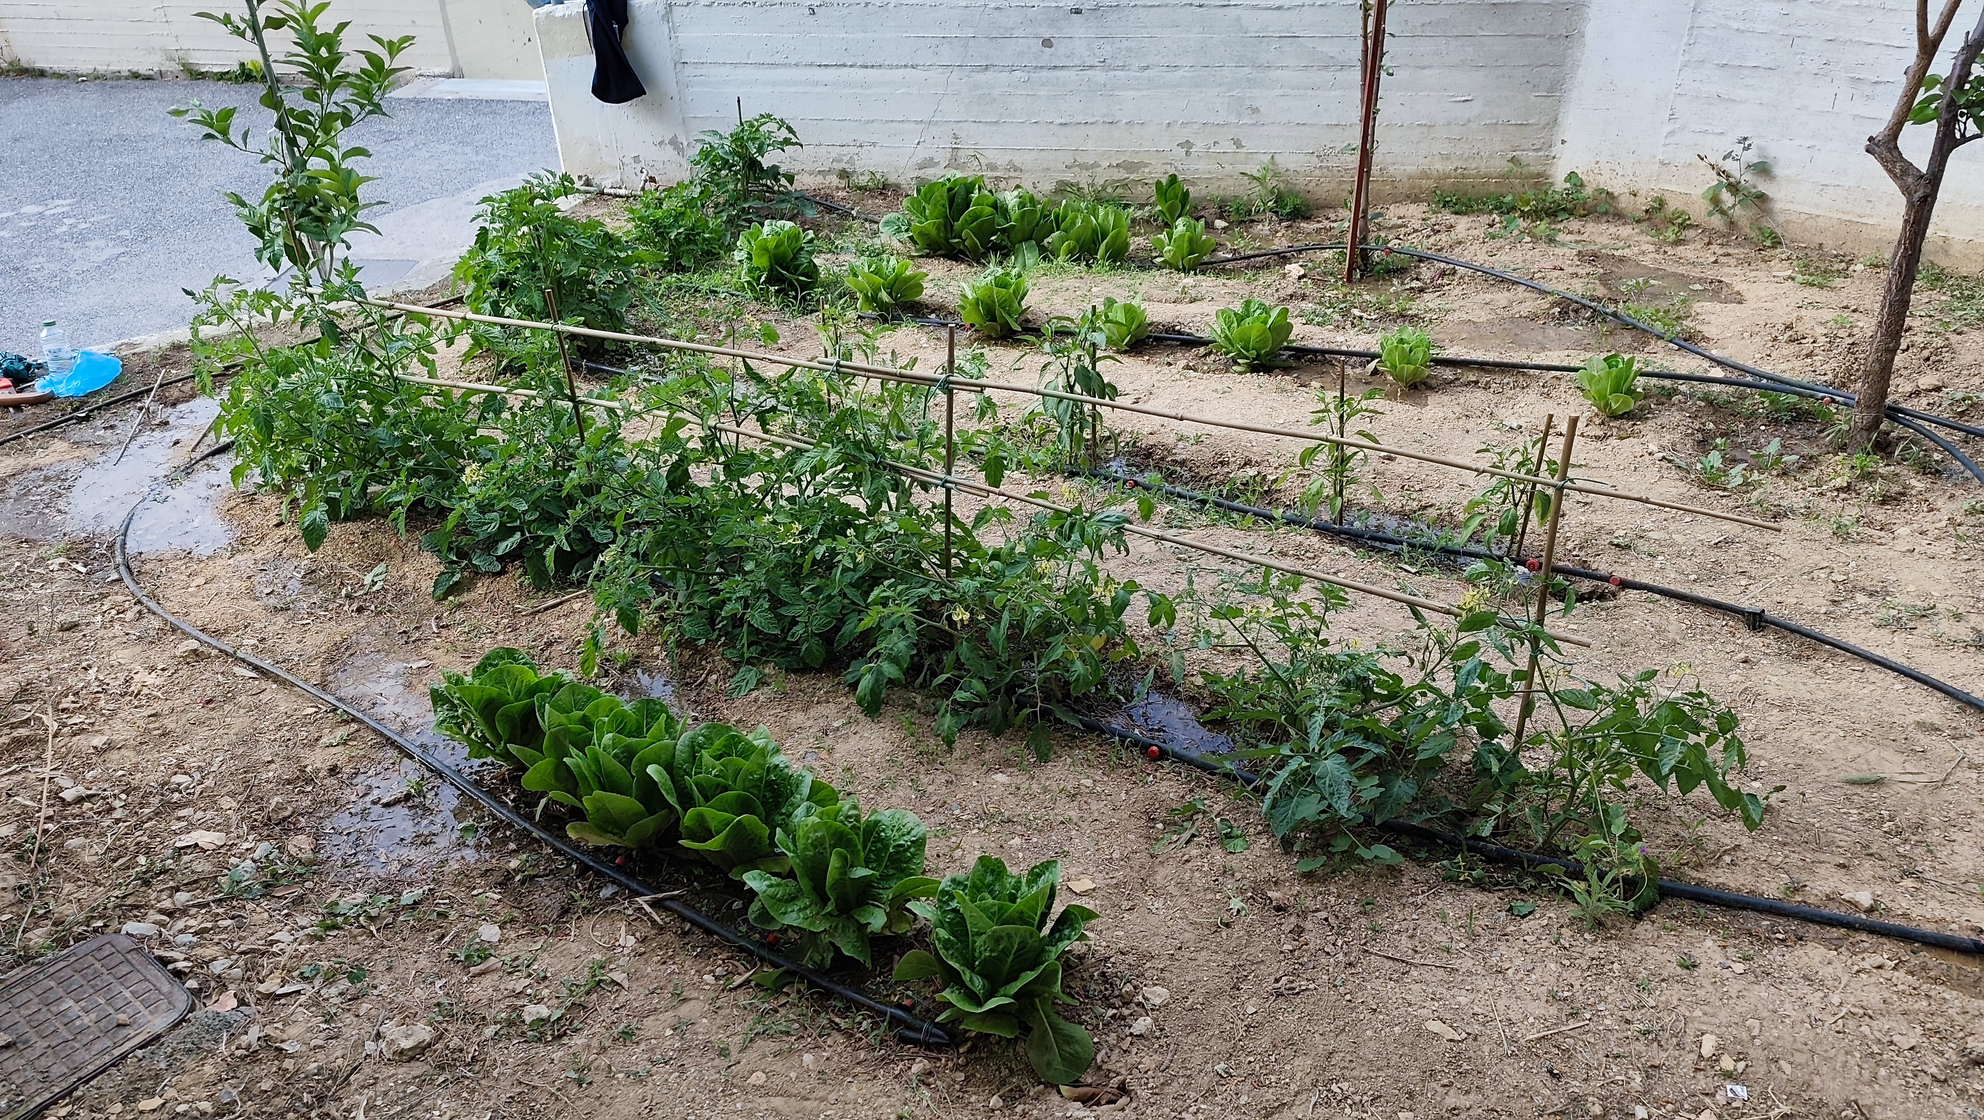

Slide 16
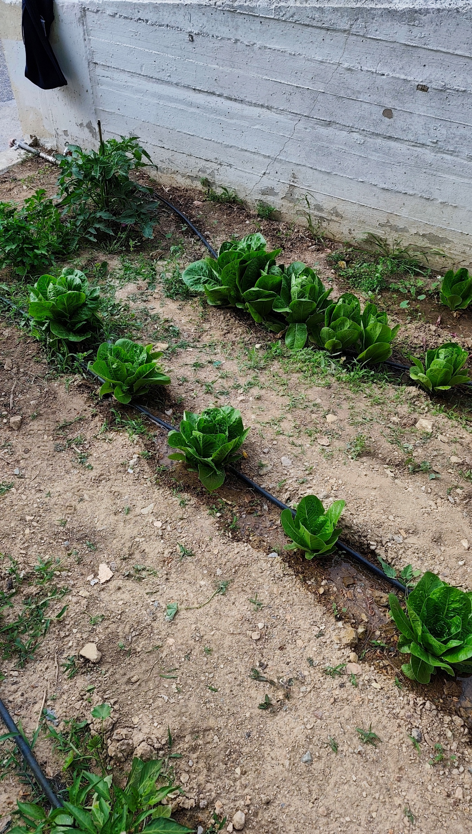
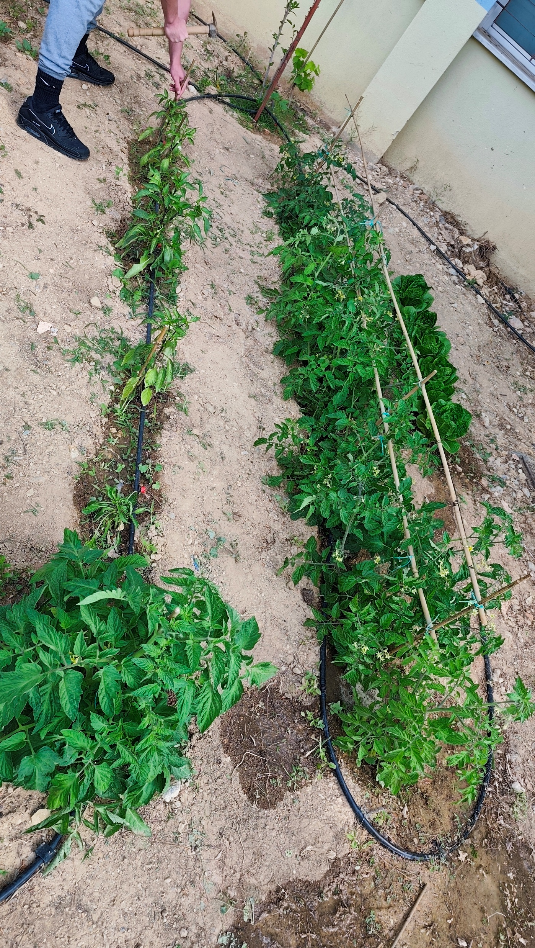

Slide 17
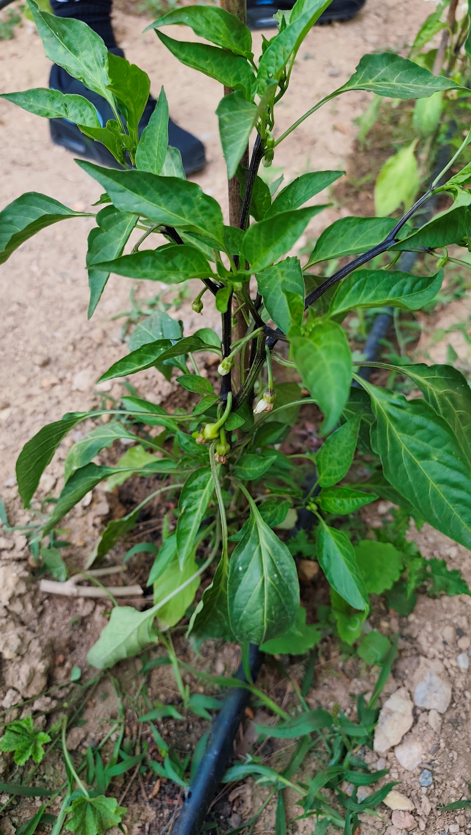
until we finally enjoyed the fruits of our labors...

Slide 18
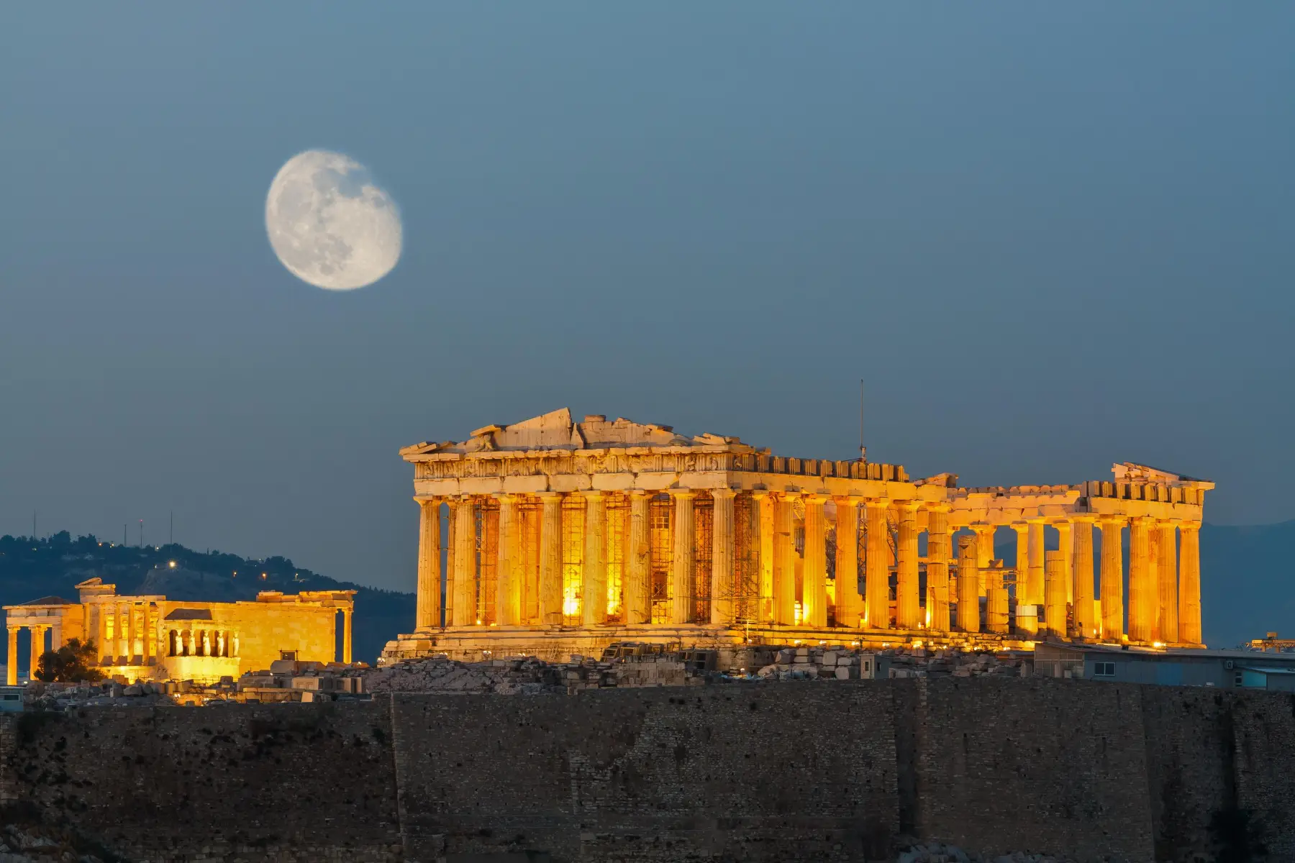
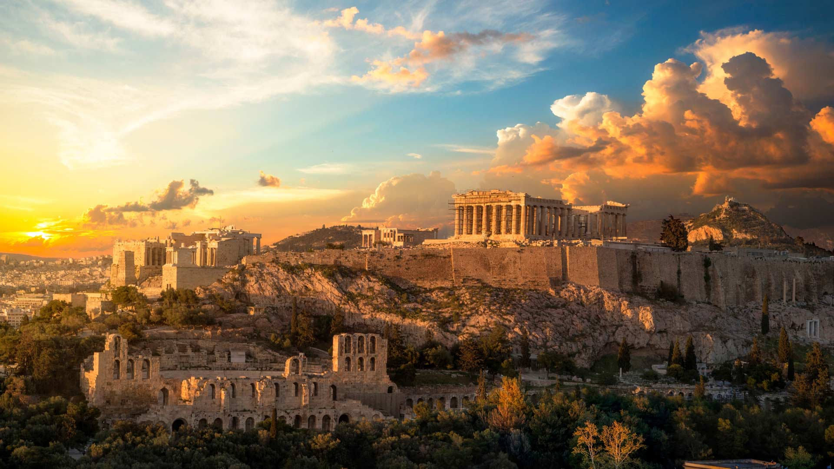
Dear partners, we look forward to welcoming and hosting you in the land of mythology, Greece.

