Slide 1





Toolkit implementation
in school

Slide 2
Workshop Objectives:
Participants will:
  Explore digital tools that support students with diverse needs.
  Create inclusive learning materials using apps.
  Get ideas for engaging inclusive classroom activities.

Slide 3
https://www.mentimeter.com/app/presentation/aljuq25sj5m794befwdzuehccnt5wyuz/edit?comment=true&question=vp6y7xrtc2q5

Slide 4

what are the adventages of using different toolkit on lessons?

Slide 5
Working with Apps
They support the implementation of teaching goals
They increase student engagement
They enable individualized teaching
They introduce current topics and modern methods

Slide 6
Pair discussion
Teachers: What apps do you already use and why?
Students: How do apps that you use
impact (or influence) your lesson?

Slide 7
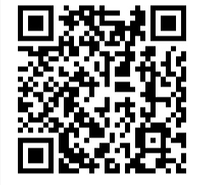
Making Crosswords
https://puzzel.org/en
https://www.crossword-generator.com/pl

Slide 8
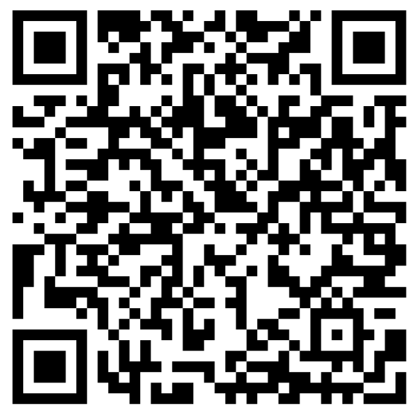
LearningApps

Slide 9
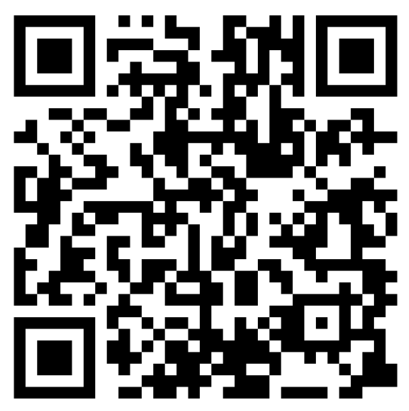
LearningApps

Slide 10
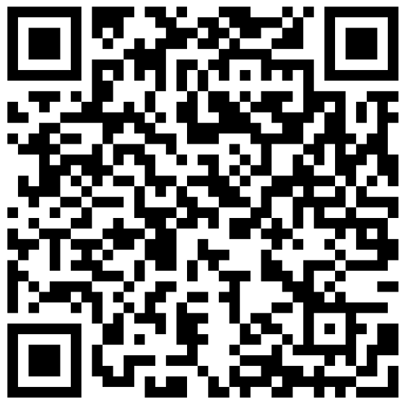
LearningApps

Slide 11
Genially
Wheel

Slide 12
Canva

Slide 13
WordArt
https://wordart.com/create
www.freewordcloudgenerator.pl

Slide 14
Wordwall
ChatGPT
Kahoot
WordArt
LearningApps
Genially
Canva

Slide 15


