Slide 1


“What is an Inclusive Toolkit?”
Nazmije zejneli-team leader
Bujar ziberi-
19.05.2025
1 BORA ADEMI
2. VLORA REXHA
3.EDA MUAREMI
4. NORA MAMUDI

Slide 2
Introduction
Purpose of the session
“Today, we’ll explore inclusive tools and strategies that empower all learners.”
Students have diverse needs, abilities, learning styles, and backgrounds.
Inclusive tools help personalize learning so all students can access and engage with content effectively.

Slide 3
What is the Inclusive Toolkit?
Definition: The Inclusive Toolkit is a collection of guidelines, tools, and resources that support the intentional creation of inclusive spaces, systems, and practices, ensuring equal access and opportunity for all individuals..

Slide 4
What is the Inclusive Toolkit?
Goal: The main goal is to eliminate barriers and promote diversity, equity, and inclusion (DEI) by:
Encouraging empathy-driven design and decision-making
Addressing bias, discrimination, and underrepresentation
Supporting accessibility for people with different abilities
Ensuring cultural sensitivity and respect for all identities
Fostering belonging and participation across diverse groups

Slide 5
Assistive tools examples-natural reader
Screen readers
Speech-to text tools
Text-to-speech tools (read and write)
Sign language
Inclusive communications platforms (Microsoft teams/Zoom

Slide 6
Inclusive strategies-UDL,visual aids, flexible grouping
In an inclusive classroom, flexible grouping can support learners by allowing them to work together in ways that maximize their strengths.
The role of Universal Design for Learning (UDL) in inclusive education, focusing on accelerating learning for diverse students. UDL, rooted in inclusivity, offers a framework for removing educational barriers and promoting individualized learning.

Slide 7
Our contribution-What we added to the toolkit
We can conntribute and encourage them through difficult moments.
develop policies and training for cross-cultural awareness
encourage everyone to have a more inclusive attitude

Slide 8
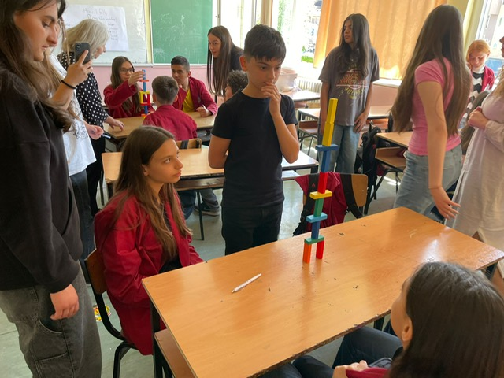

Slide 9
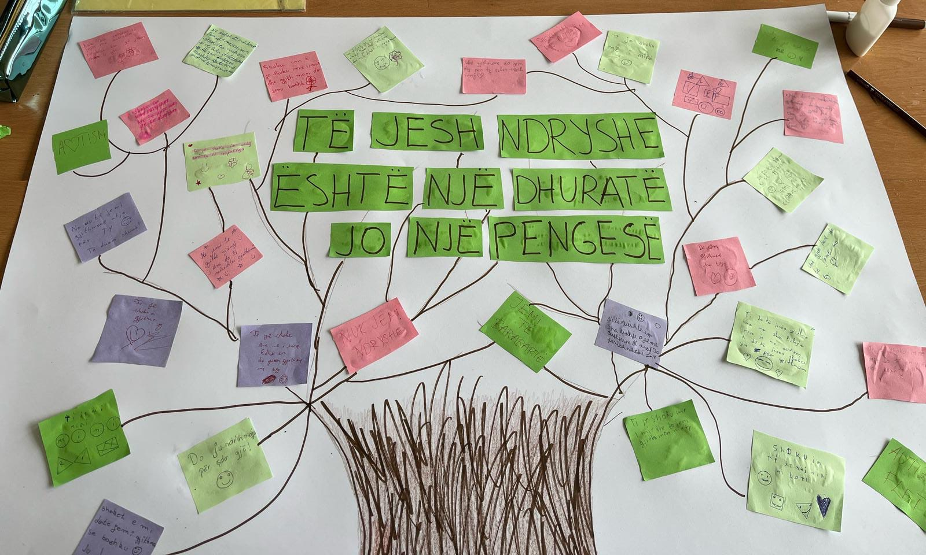

Slide 10
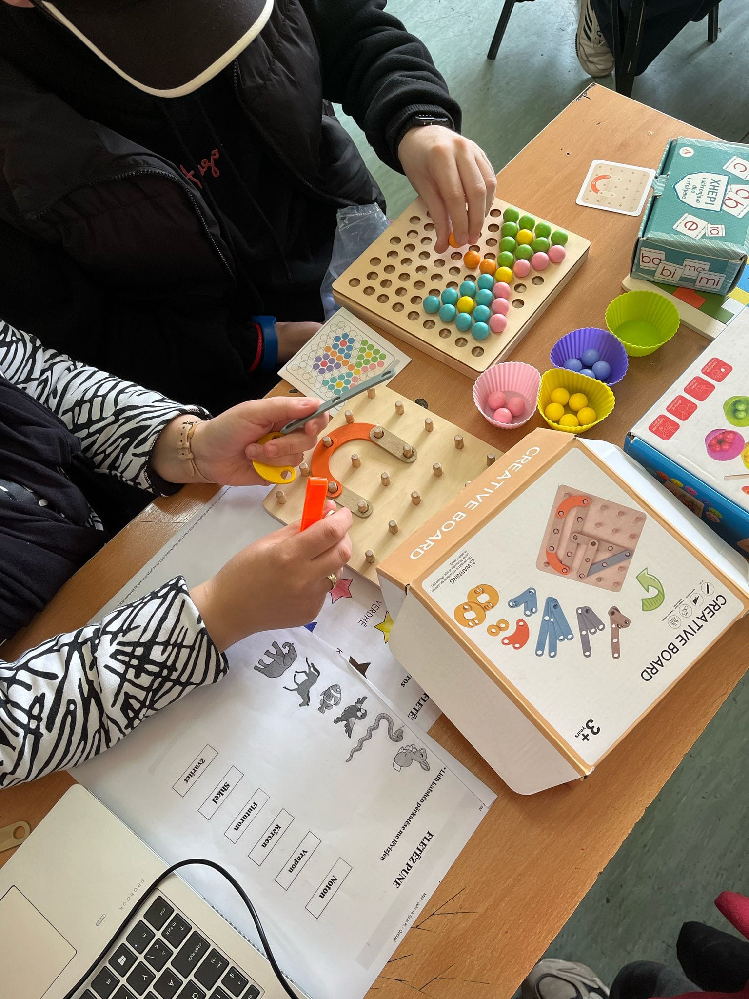
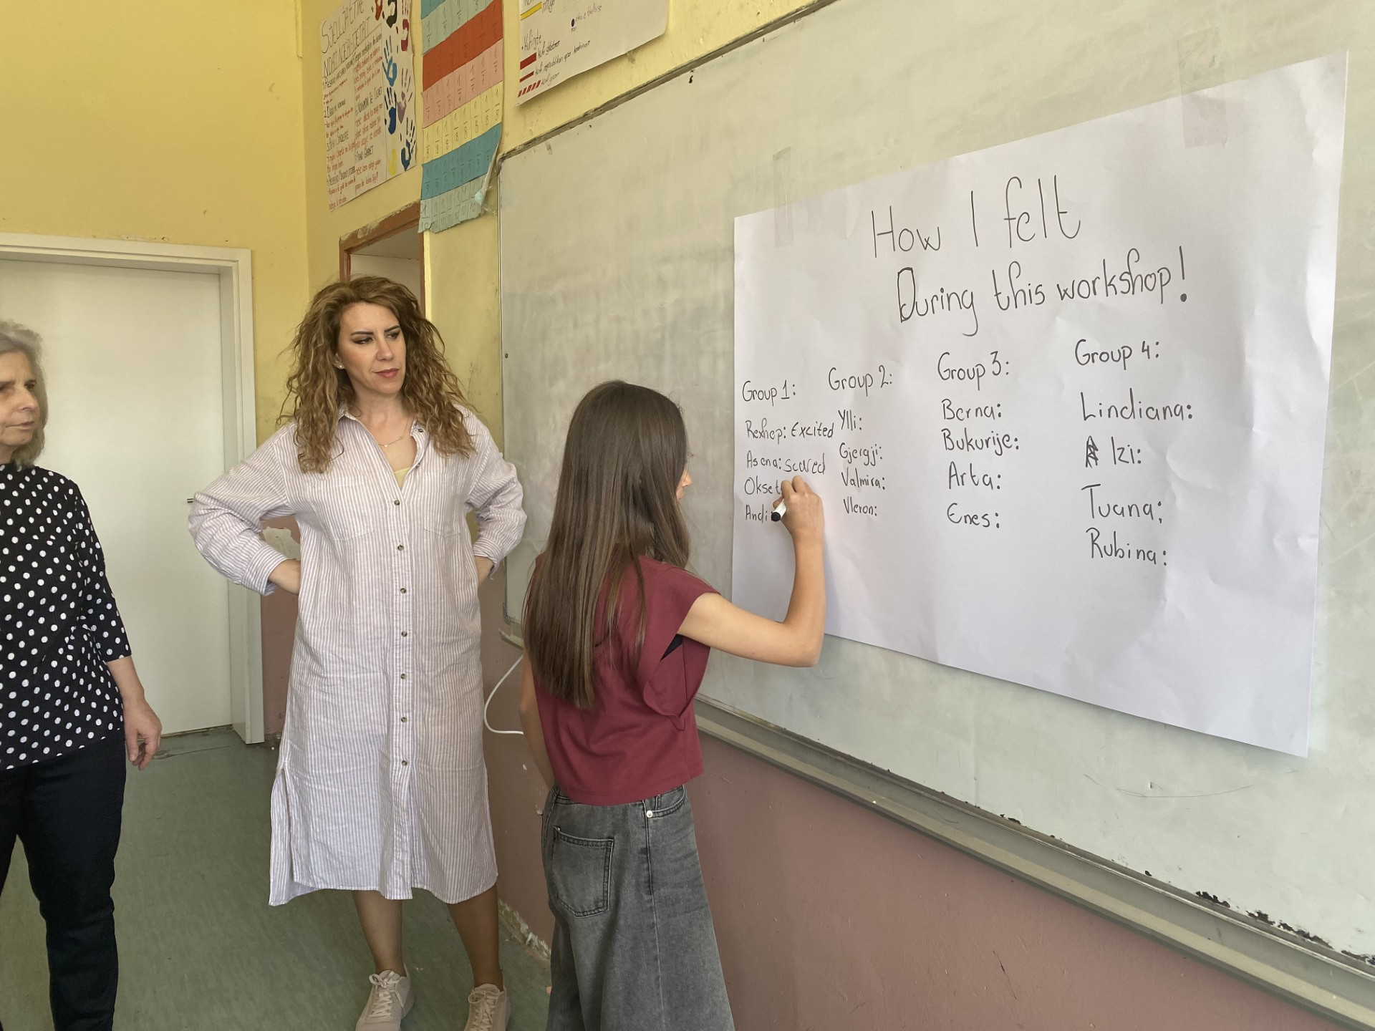
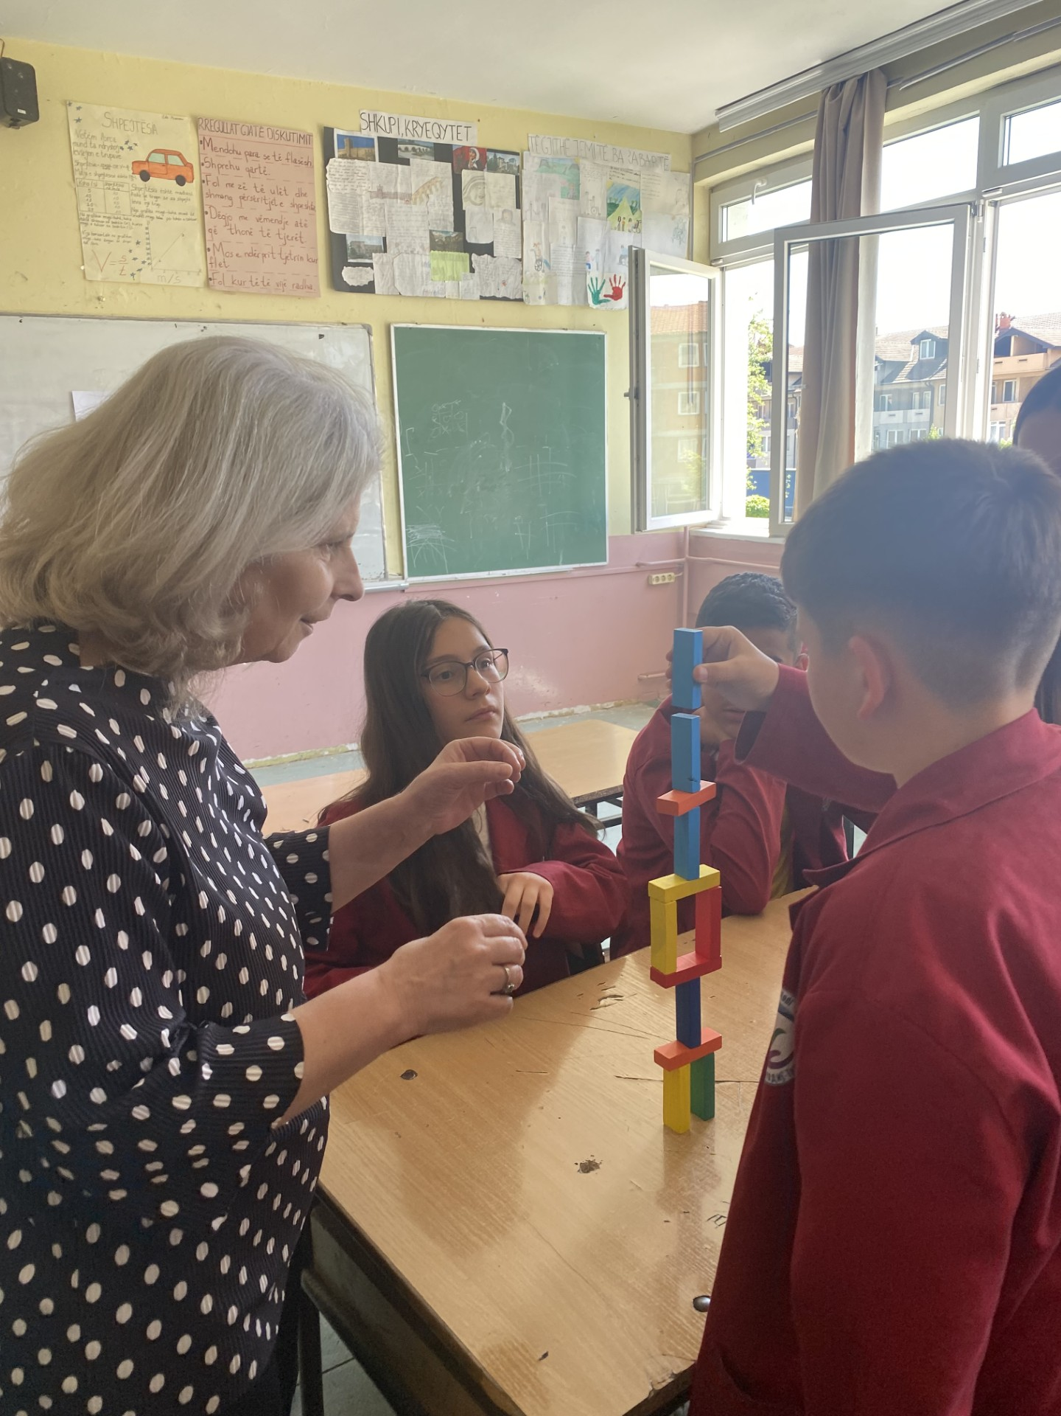
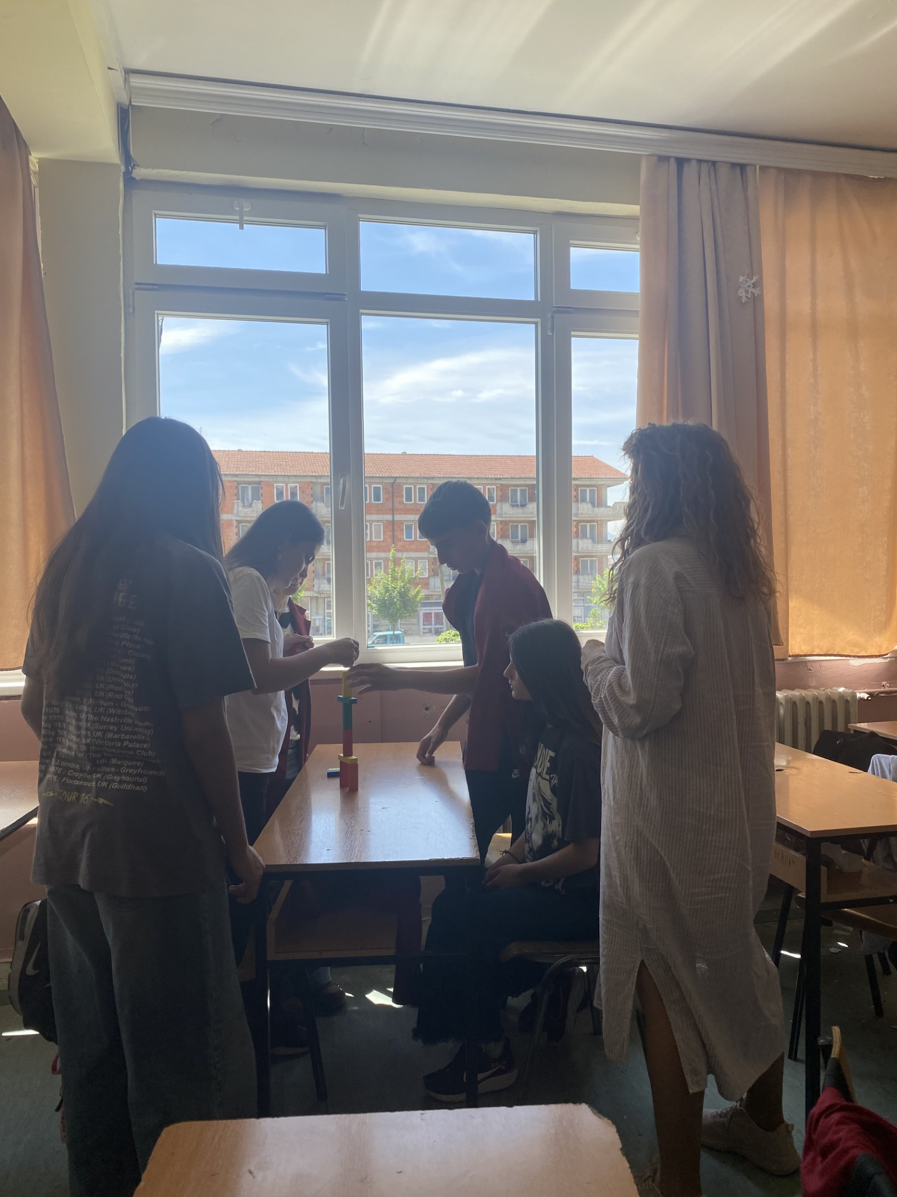
Practical scenario

Slide 11
Impact and reflection
How did you feel when your voice and actions were limited?
How did it feel when others made space you to participate?
What surprised you about your experience today?

Slide 12
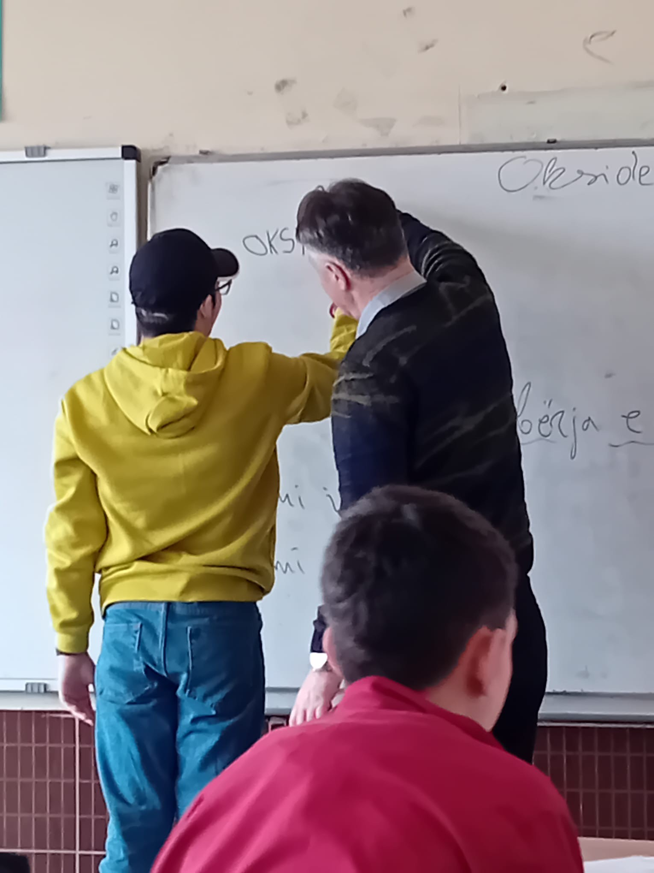

Slide 13


