Slide 1
Technology Connects Us All
SECONDARY SCHOOL “NIKOS KAVADIAS”, PERAMA,GREECE
STUDENTS : ELENI KALLERGI, ELISAVET ANASTASIADI, CHRYSOYLA ZREIKA

Slide 2
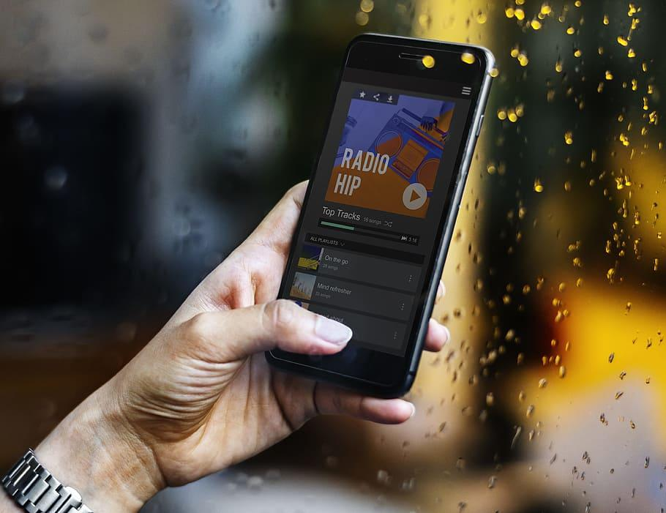
Applications for all
Technology breaks barriers, empowering people with disabilities.
From AI-powered vision to voice control and real-time transcription,
these apps—, Voice Access, Seeing AI, Ava,Be My Eyes, Eva facial mouse—bring independence and inclusion.

Slide 3
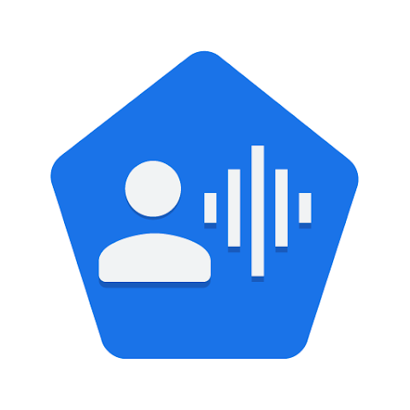

Voice Access (Android)
A voice control app by Google that allows people with mobility impairments to navigate their phone hands-free.

Slide 4
Pros and Cons
Pros:
Excellent voice recognition
Deep integration with Android features
Completely free
Cons:
Only available on Android
May struggle with noisy environments
Some commands can be complex for new users

Slide 5
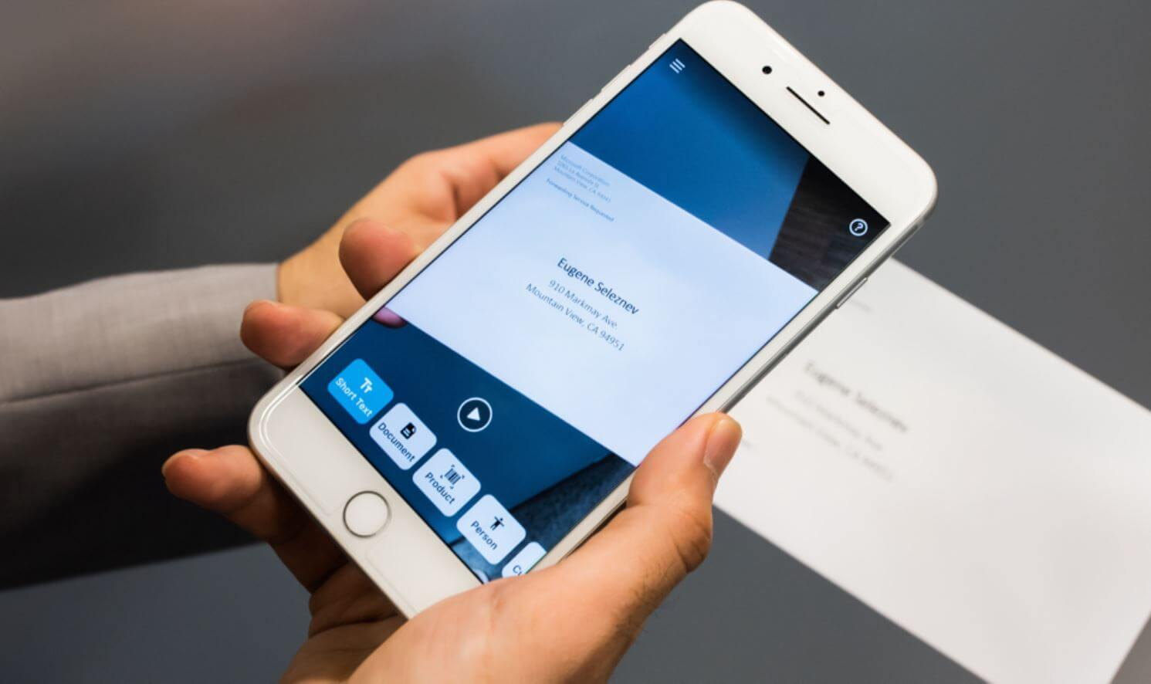



Seeing AI (iOS)
A Microsoft AI-powered app that helps blind or visually impaired users by describing the world around them using their phone’s camera.

Slide 6
Pros and cons
Pros:
Recognizes text, objects, and even people
Works offline for some features
Free and easy to use
Cons:
Limited language support
Best performance on newer iPhones
Some recognition errors, especially in low light

Slide 7

Ava (iOS & Android)
A real-time transcription app that converts speech into text for people who are deaf or hard of hearing.

Slide 8
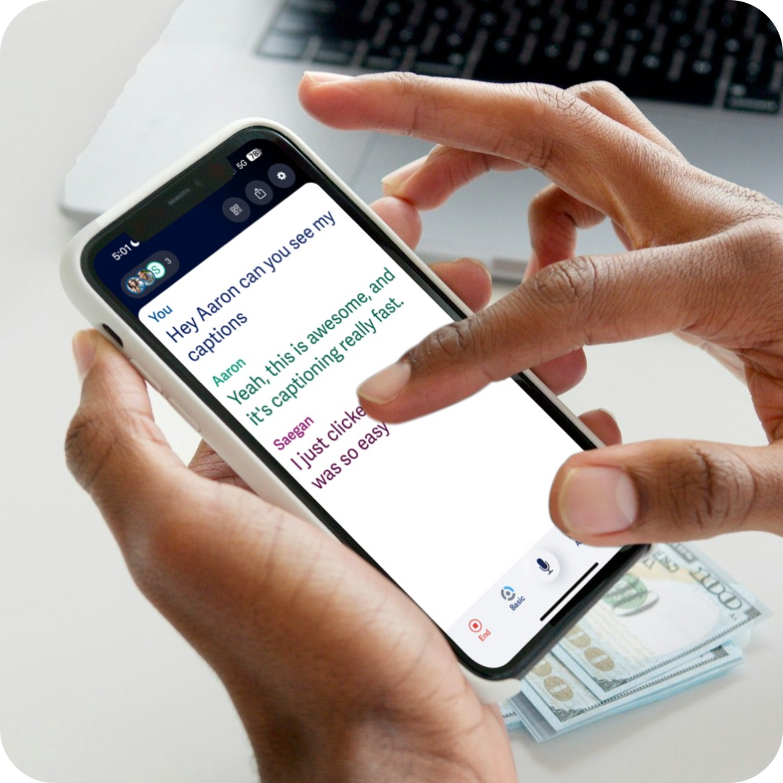
Pros and cons
Pros:
High transcription accuracy
Works in group conversations
Supports multiple languages
Cons:
Free version has limited minutes per month
Requires an internet connection for best performance
Background noise can affect accuracy

Slide 9

Be My Eyes (iOS & Android)
A free app that connects visually impaired users with sighted volunteers who provide real-time assistance via video calls.

Slide 10
Pros and Cons
Pros:
Free to use
Large network of volunteers available 24/7
Simple and intuitive interface
Cons:
Requires an internet connection
Volunteer availability may vary
Not suitable for private or sensitive information

Slide 11
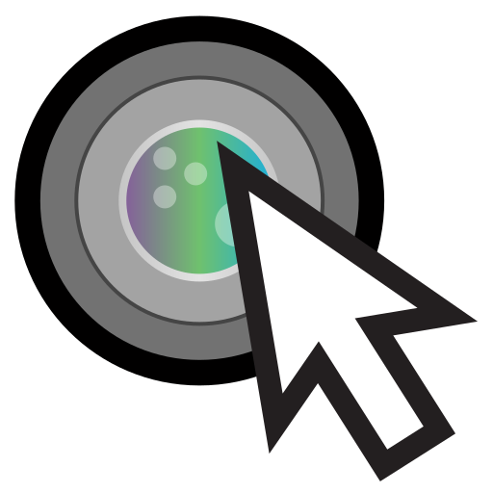
EVA Facial Mouse (Android)
Eva Facial Mouse is an Android application designed to help users with motor disabilities control their devices using head movements.
It allows users to interact with smartphones and tablets without needing to touch the screen, which is particularly beneficial for individuals with limited hand mobility.

Slide 12
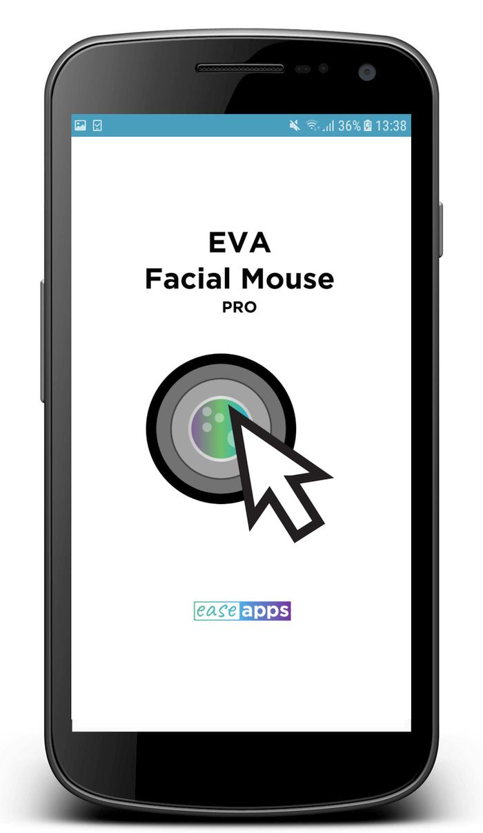
Pros and Cons
Pros
Accessibility for users with limited hand mobility
Customizable sensitivity
Free to use
Easy setup
Cons
Limited compatibility to android devices
Requires good lighting
Limited functionality in some apps

Slide 13
Conclusion
These applications significantly enhance accessibility for individuals with disabilities .
Choosing the right solution depends on personal needs, device compatibility,
and available resources. Innovations in assistive technology continue to improve accessibility and independence.

Slide 14

Thank you!

