Slide 1


Slide 2


Slide 3

Sustainable Solutions to Reduce Food
Let's find out together how to fight food waste with practical and sustainable solutions

Slide 4
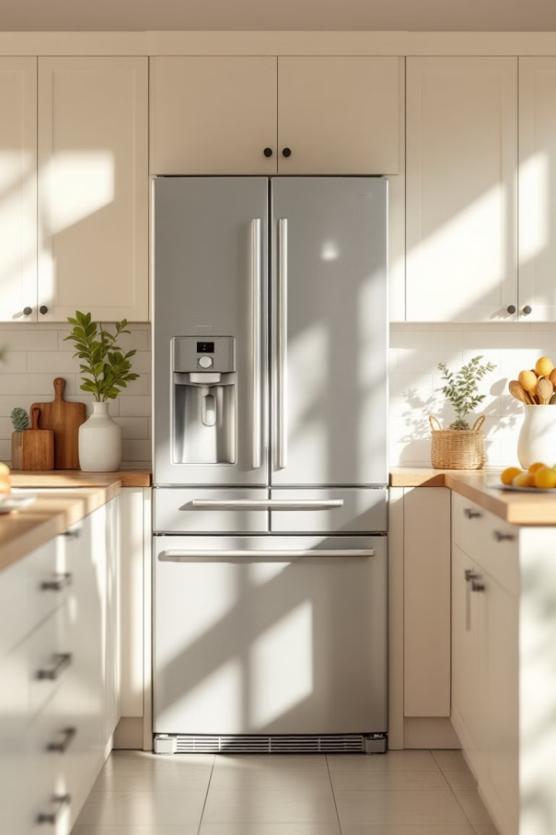
.
How to Reduce Food Wasteome
1
Why is it important
Tons of food are wasted globally every year, with devastating impacts on the environment and the economy. Reducing food waste not only saves money at home, but also helps reduce the carbon footprint and preserve our planet's natural resources. Adopting sustainable practices in food management is a fundamental step towards a more equitable and environmentally friendly future..
2
Plan your meals
Create a detailed weekly menu, taking into account the ingredients already present in the house and the preferences of all family members. Use a precise and updated shopping list, avoiding impulse purchases. Organizing the meals of the week not only helps you buy only what you need, but also simplifies food preparation and reduces the risk of waste.
3
Reuse leftovers
Get creative with leftovers and turn them into new and tasty dishes. Leftover chicken can be made into a tasty salad, a nutritious soup, or a filling for tasty tortillas. Freeze excess food in individual or family.

Slide 5
Environmental impact of food waste
1
LOSS OF NATURAL RESOURCES
2
GREENHOUSE GAS EMISSIONS
Food waste leads to inefficient use of natural resources, such as water and soil, contributing to ecological problems such as deforestation and the decline of biodiversity.
Wasted food, decomposing in landfill, releases methane, a powerful greenhouse gas, worsening climate change and making it urgent to reduce food waste.

Slide 6

Community Benefits
Greater food safet
Greener economy
More respect for the environment
Reducing food waste means better distributing resources, helping those most in need and fighting hunger.
Local initiatives against food waste boost the economy, creating jobs and supporting local producers and farmers. .
Teaching children to reduce food waste helps protect the environment and combat climate change.

Slide 7


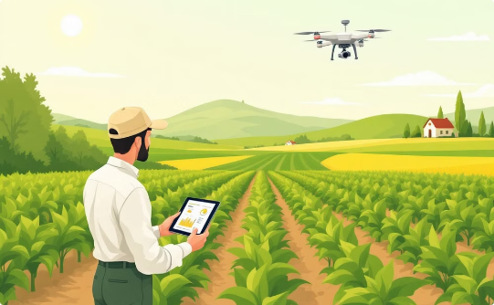
Sustainability and Future
Shared commitment
Awareness
Innovation
Collaboration between individuals, companies and governments for sustainable solutions.
Education and awareness for responsible behavior and reduction of environmental impact.
Innovative technologies to optimize the use of resources and ensure fairness and respect for the environment.

Slide 8

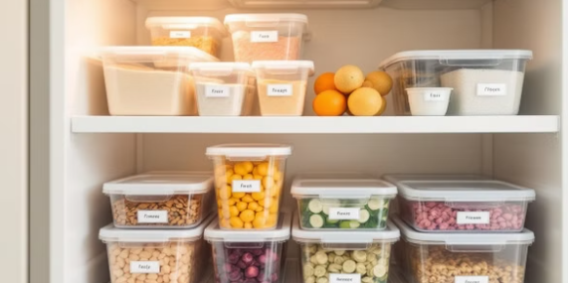
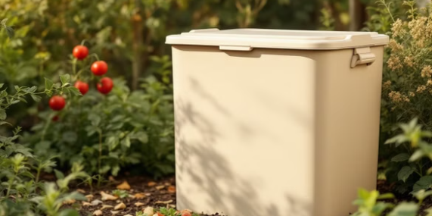
Advanced Anti-Waste Strategies
Implement these advanced strategies to further reduce food waste, adopting a more conscious and sustainable approach
Turn Scraps into Vegetable Stock: Use vegetable scraps like carrots, celery, and onions to make a homemade vegetable stock that’s packed with flavor and nutrients. Strain the stock and refrigerate or freeze for later use in soups, risottos, and sauces.
Organize your freezer for better storage: Divide the food into portions that suit your needs and freeze them in containers or bags labeled with the date. This way, you can easily identify and use the food before it spoils, avoiding waste.
Start Composting: Create a composting corner in your garden or use an indoor composter to turn food scraps, such as fruit and vegetable peels, coffee grounds and tea filters, into a natural, nutrient-rich fertilizer for your plants.
Grow herbs to reduce shopping: Create a small herb garden on your balcony or in your kitchen. This way, you will always have fresh herbs such as basil, parsley, rosemary and thyme available, reducing the need to buy them at the supermarket and preventing them from withering in the refrigerator.

Slide 9
.
Optimal Food Preservation
Temperature control
Labeling
Check the temperature of your refrigerator (between 0°C and 4°C) and freezer (around -18°C) regularly to ensure food safety.
Always label containers with the freezing date to keep track of freshness and consume foods within the recommended time frame.
1
2
3
Adequate Portions
Freeze leftovers in portions suitable for single consumption to avoid waste and facilitate later use.

Slide 10

Sustainable Habits to Adopt
Small daily changes can make a big difference.
Plan Your Meals
Buy Consciously
Cook Creatively
Organize weekly menus to avoid impulse purchases and waste
Prefer loose products or products with minimal and recyclable packaging
Transform leftovers into new recipes, giving new life to ingredients.

Slide 11
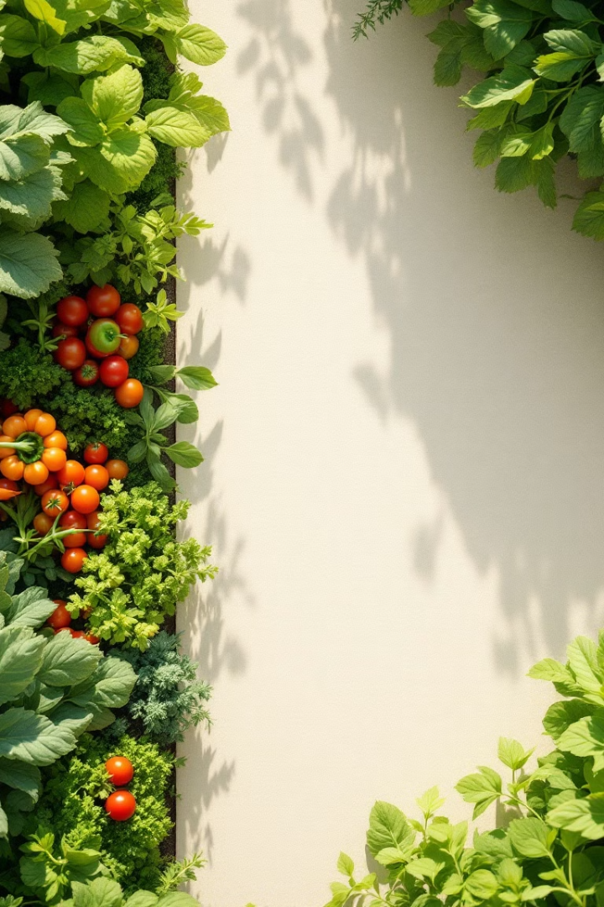
.
Future Without Waste: Let's Act Now
Every action we take counts towards a more sustainable future. Reducing waste is a duty towards the planet.
Let's start making a difference today with small daily gestures.
1
Adopt Mindful Habits
2
Involve the Community
Plan meals, shop smart, and cook creatively.
Share your knowledge and encourage others to reduce waste.
3
Support Anti-Waste Initiatives
Support companies and organizations committed to fighting food waste

Slide 12

THANK YOU
Your commitment makes a difference. Together we can build a sustainable future.

Slide 13
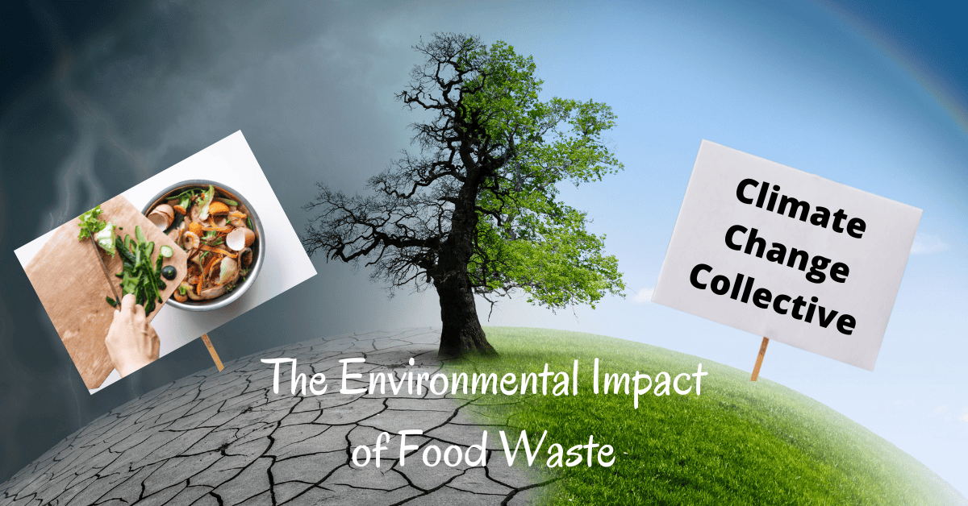
Project and presentation by:
Sara Fidah
Mariagrazia Pesce
and Michele Todaro

